Slide 1
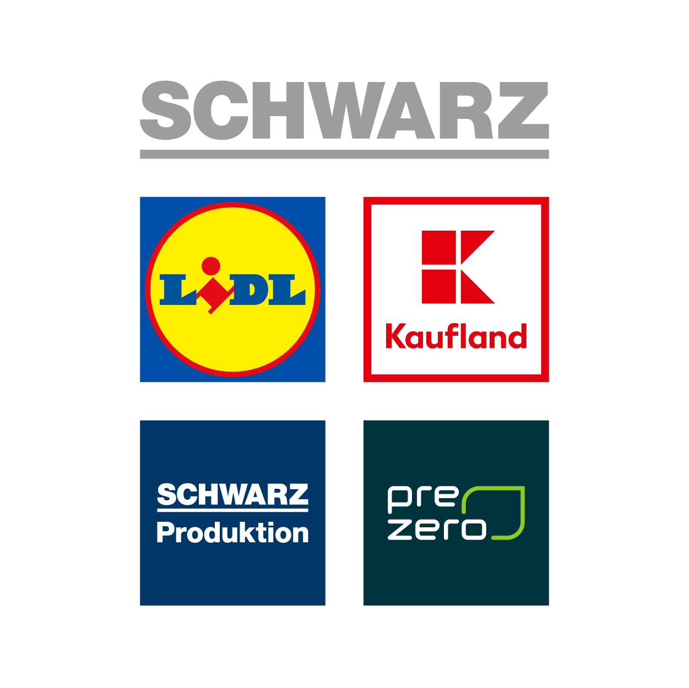
Schwarz it bulgaria
Company overview
Sofia, 2021

Slide 2
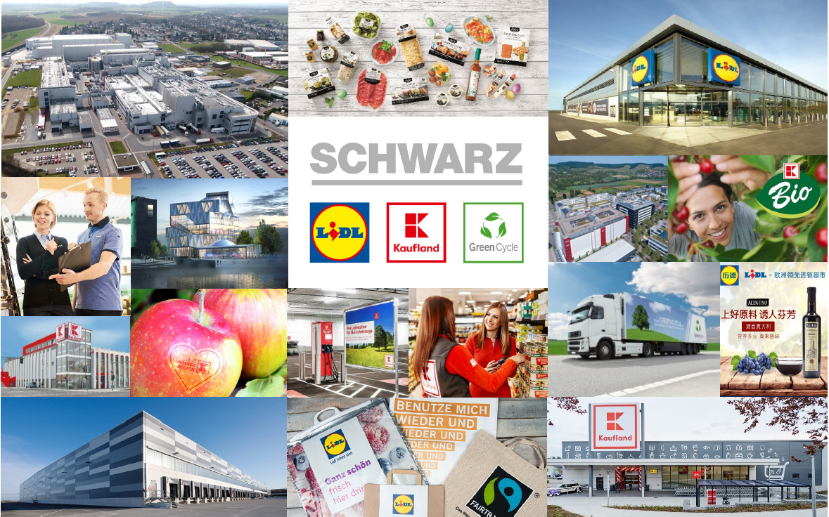
our business in the Making

Slide 3







Schwarz Group
*Net sales in FY 2018
Leading the way & setting the pace in retail
12,500
458,000
Stores worldwide
Employees worldwide
33
113.3 bn €
7.5 bn
*
active in
countries
Sales
customers every year
Make the Group sustainable
Europe's largest retailer
Less plastic – close loops

Slide 4
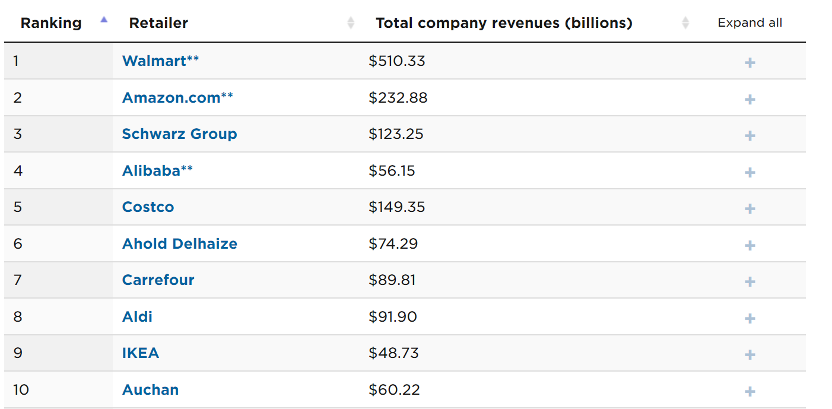
SCHWARZ GROUP
The largest European retailer

Slide 5




Schwarz Group
We focus on the things that matter
Quality
High-quality
products, daily
Price
Top quality at unbeatable prices
Efficiency
Process pros with a system
and price edge
Responsibility
Economic, social and
ecological responsibility

Slide 6
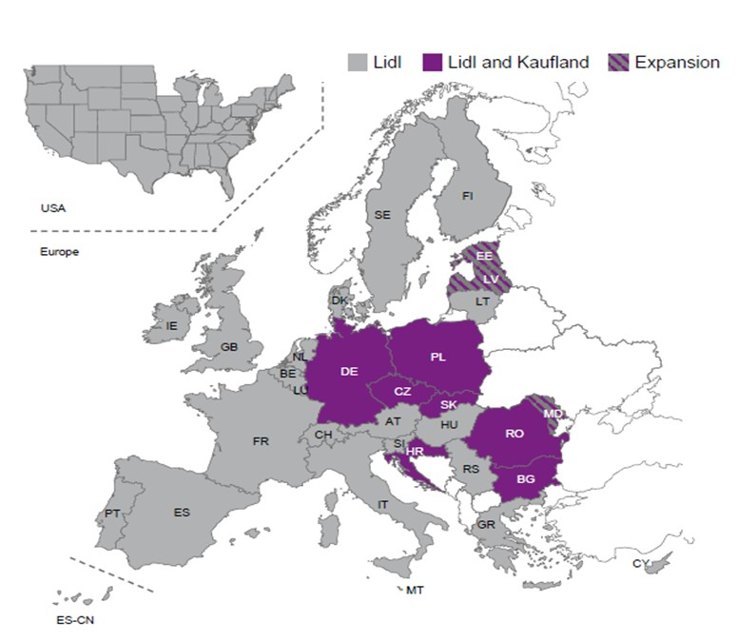
SCHWARZ GROUP
COUNTRIES OF OPERATIONS

Slide 7
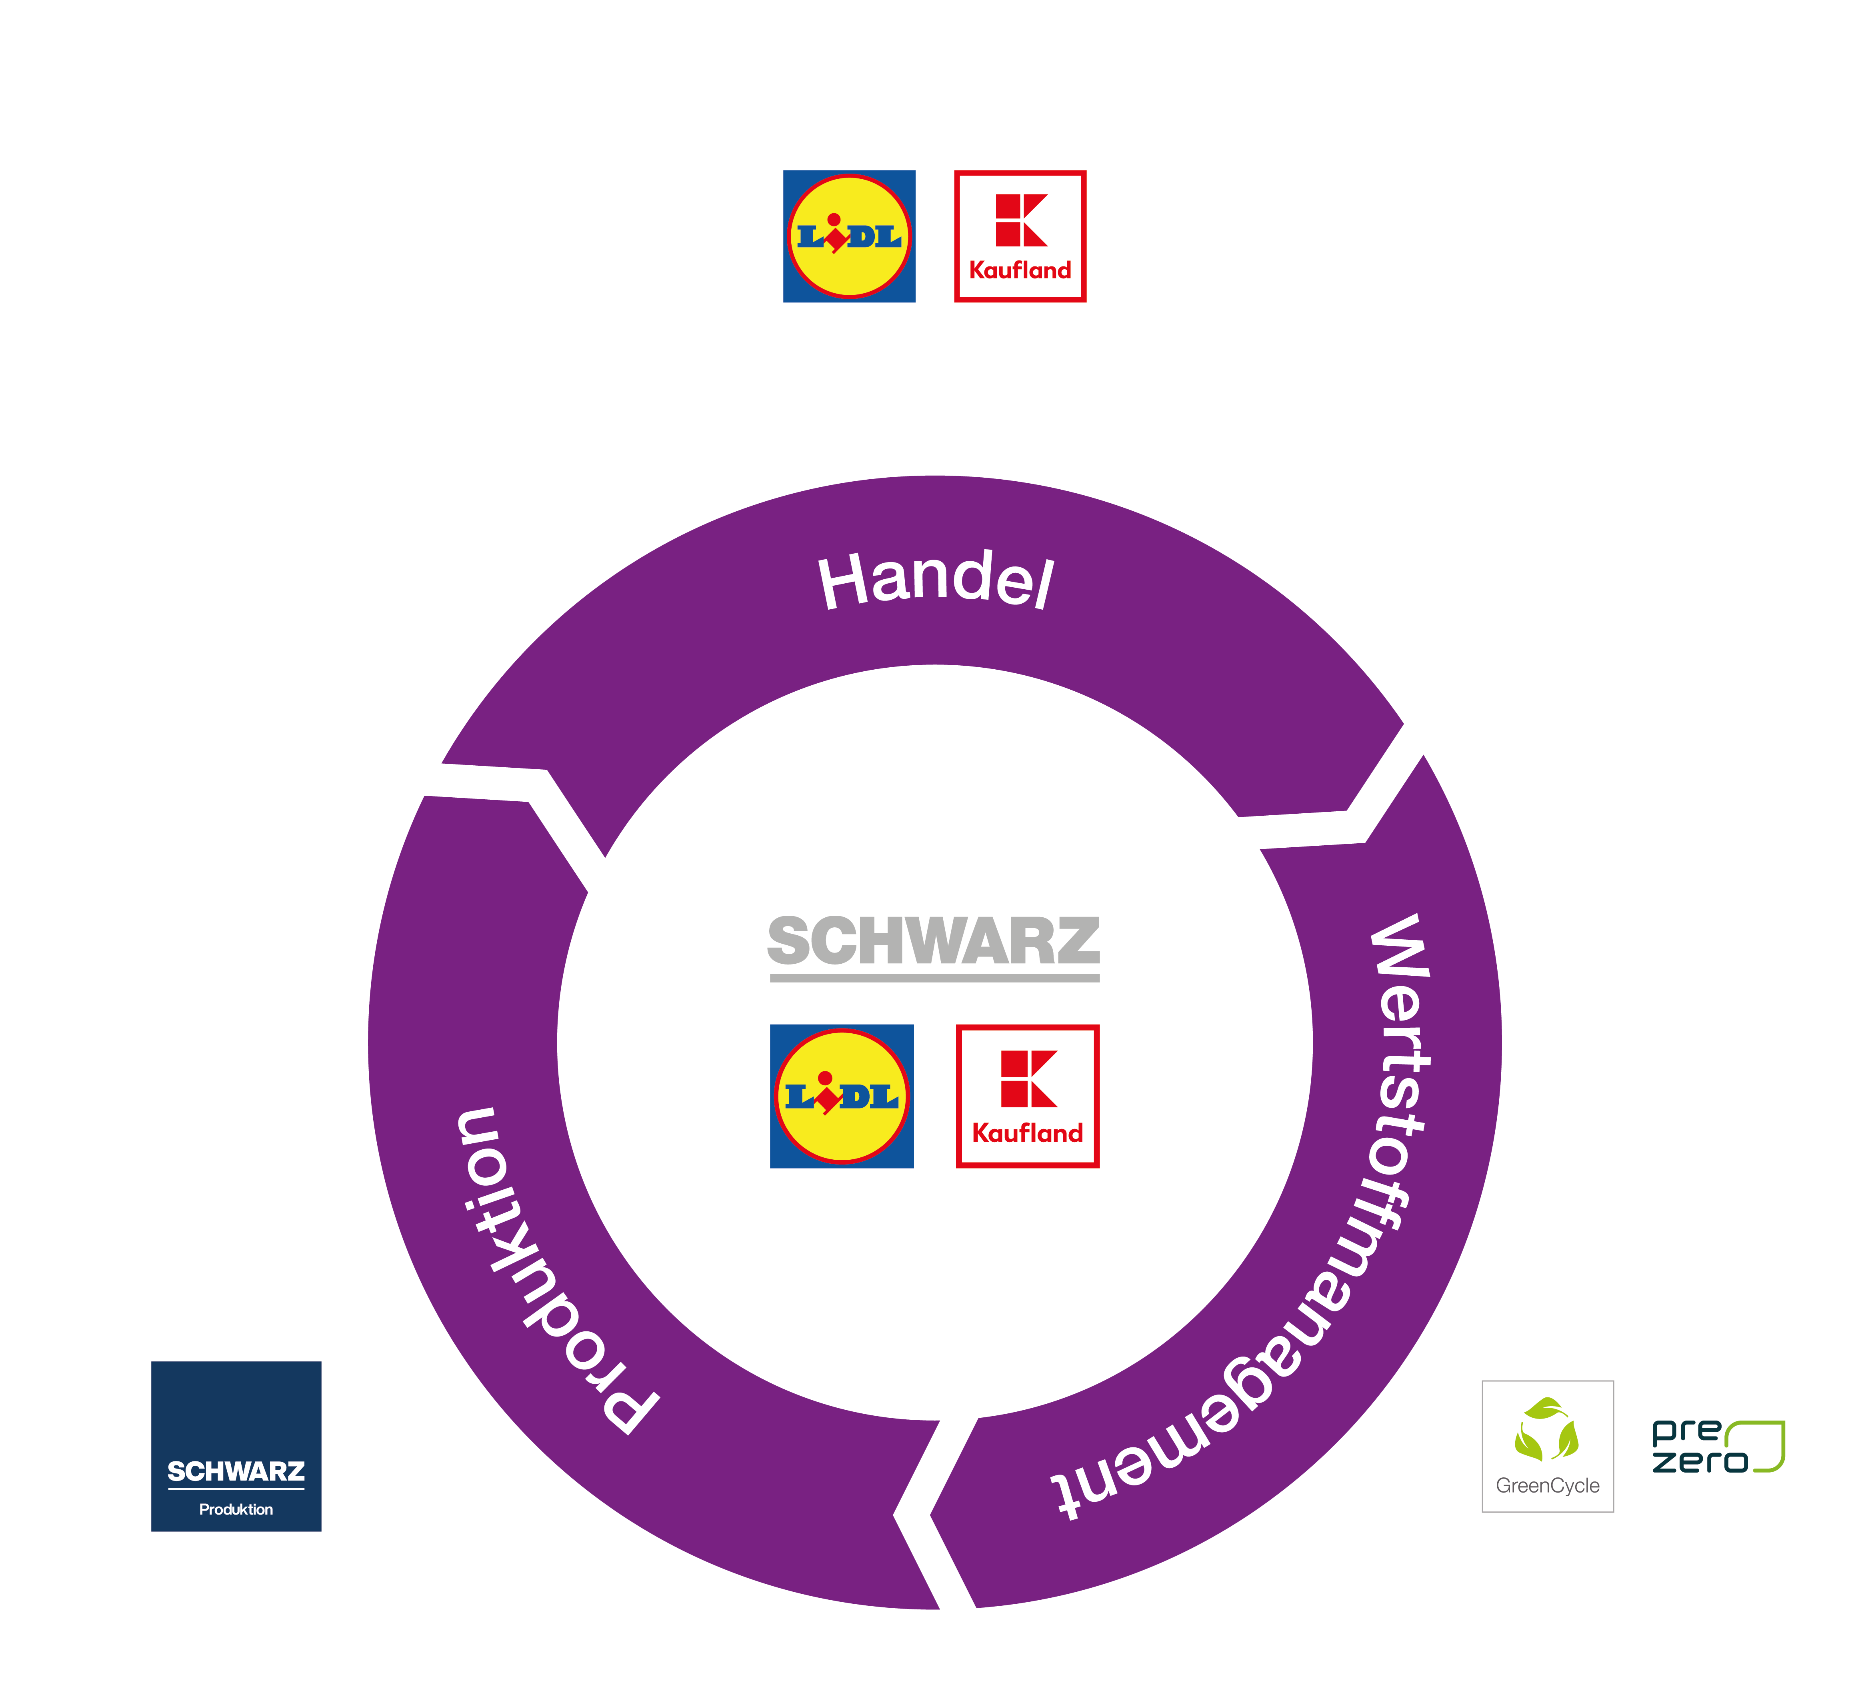

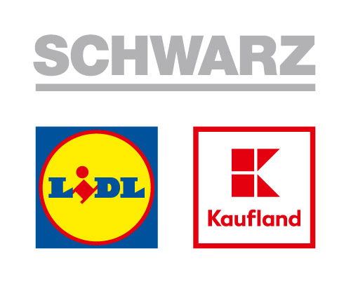

SCHWARZ GROUP
Retail
Retail
Recyclables management
Production

Slide 8





Schwarz Group
Our milestones, part I
1968
1st Handelshof
Backnang
1998
Intl. expansion begins
Czech Republic
1984
1st Kaufland self-service dept. store
Neckarsulm
1930
Founding of
Lidl & Schwarz KG
2008
MEG started as production company
1973
1st Lidl Store
Ludwigshafen
1998 – 2009
Expansion into 17 more European countries
1960
1st Cash & carry market
Heilbronn
1989
Intl. expansion begins
France
2009
Founding of GreenCycle
(Recyclables management)

Slide 9
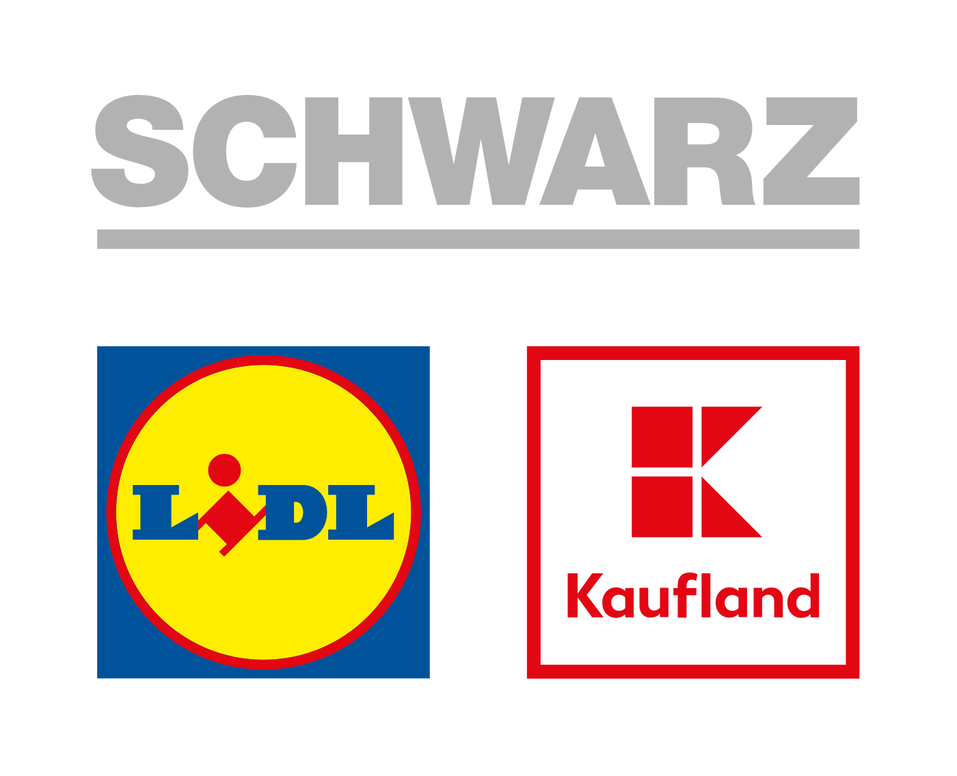


Schwarz Group
Our milestones, part II
2011
Introduction of PET recyclables loop
2018
Founding of PreZero
2019
First time reaching > 100 bn € in sales
2018
Beginning of Schwarz Group plastic strategy
2016
Commissioning of PET Recycling West recycling plant
Übach-Palenberg
2017
Expansion
USA
2018/2019
Constant expansion
2015
11,000 stores in Europe
2018
Acquired disposal company Tönsmeier / Renamed to PreZero
2020
1st of December Schwarz IT Bulgaria and the new brand logo

Slide 10
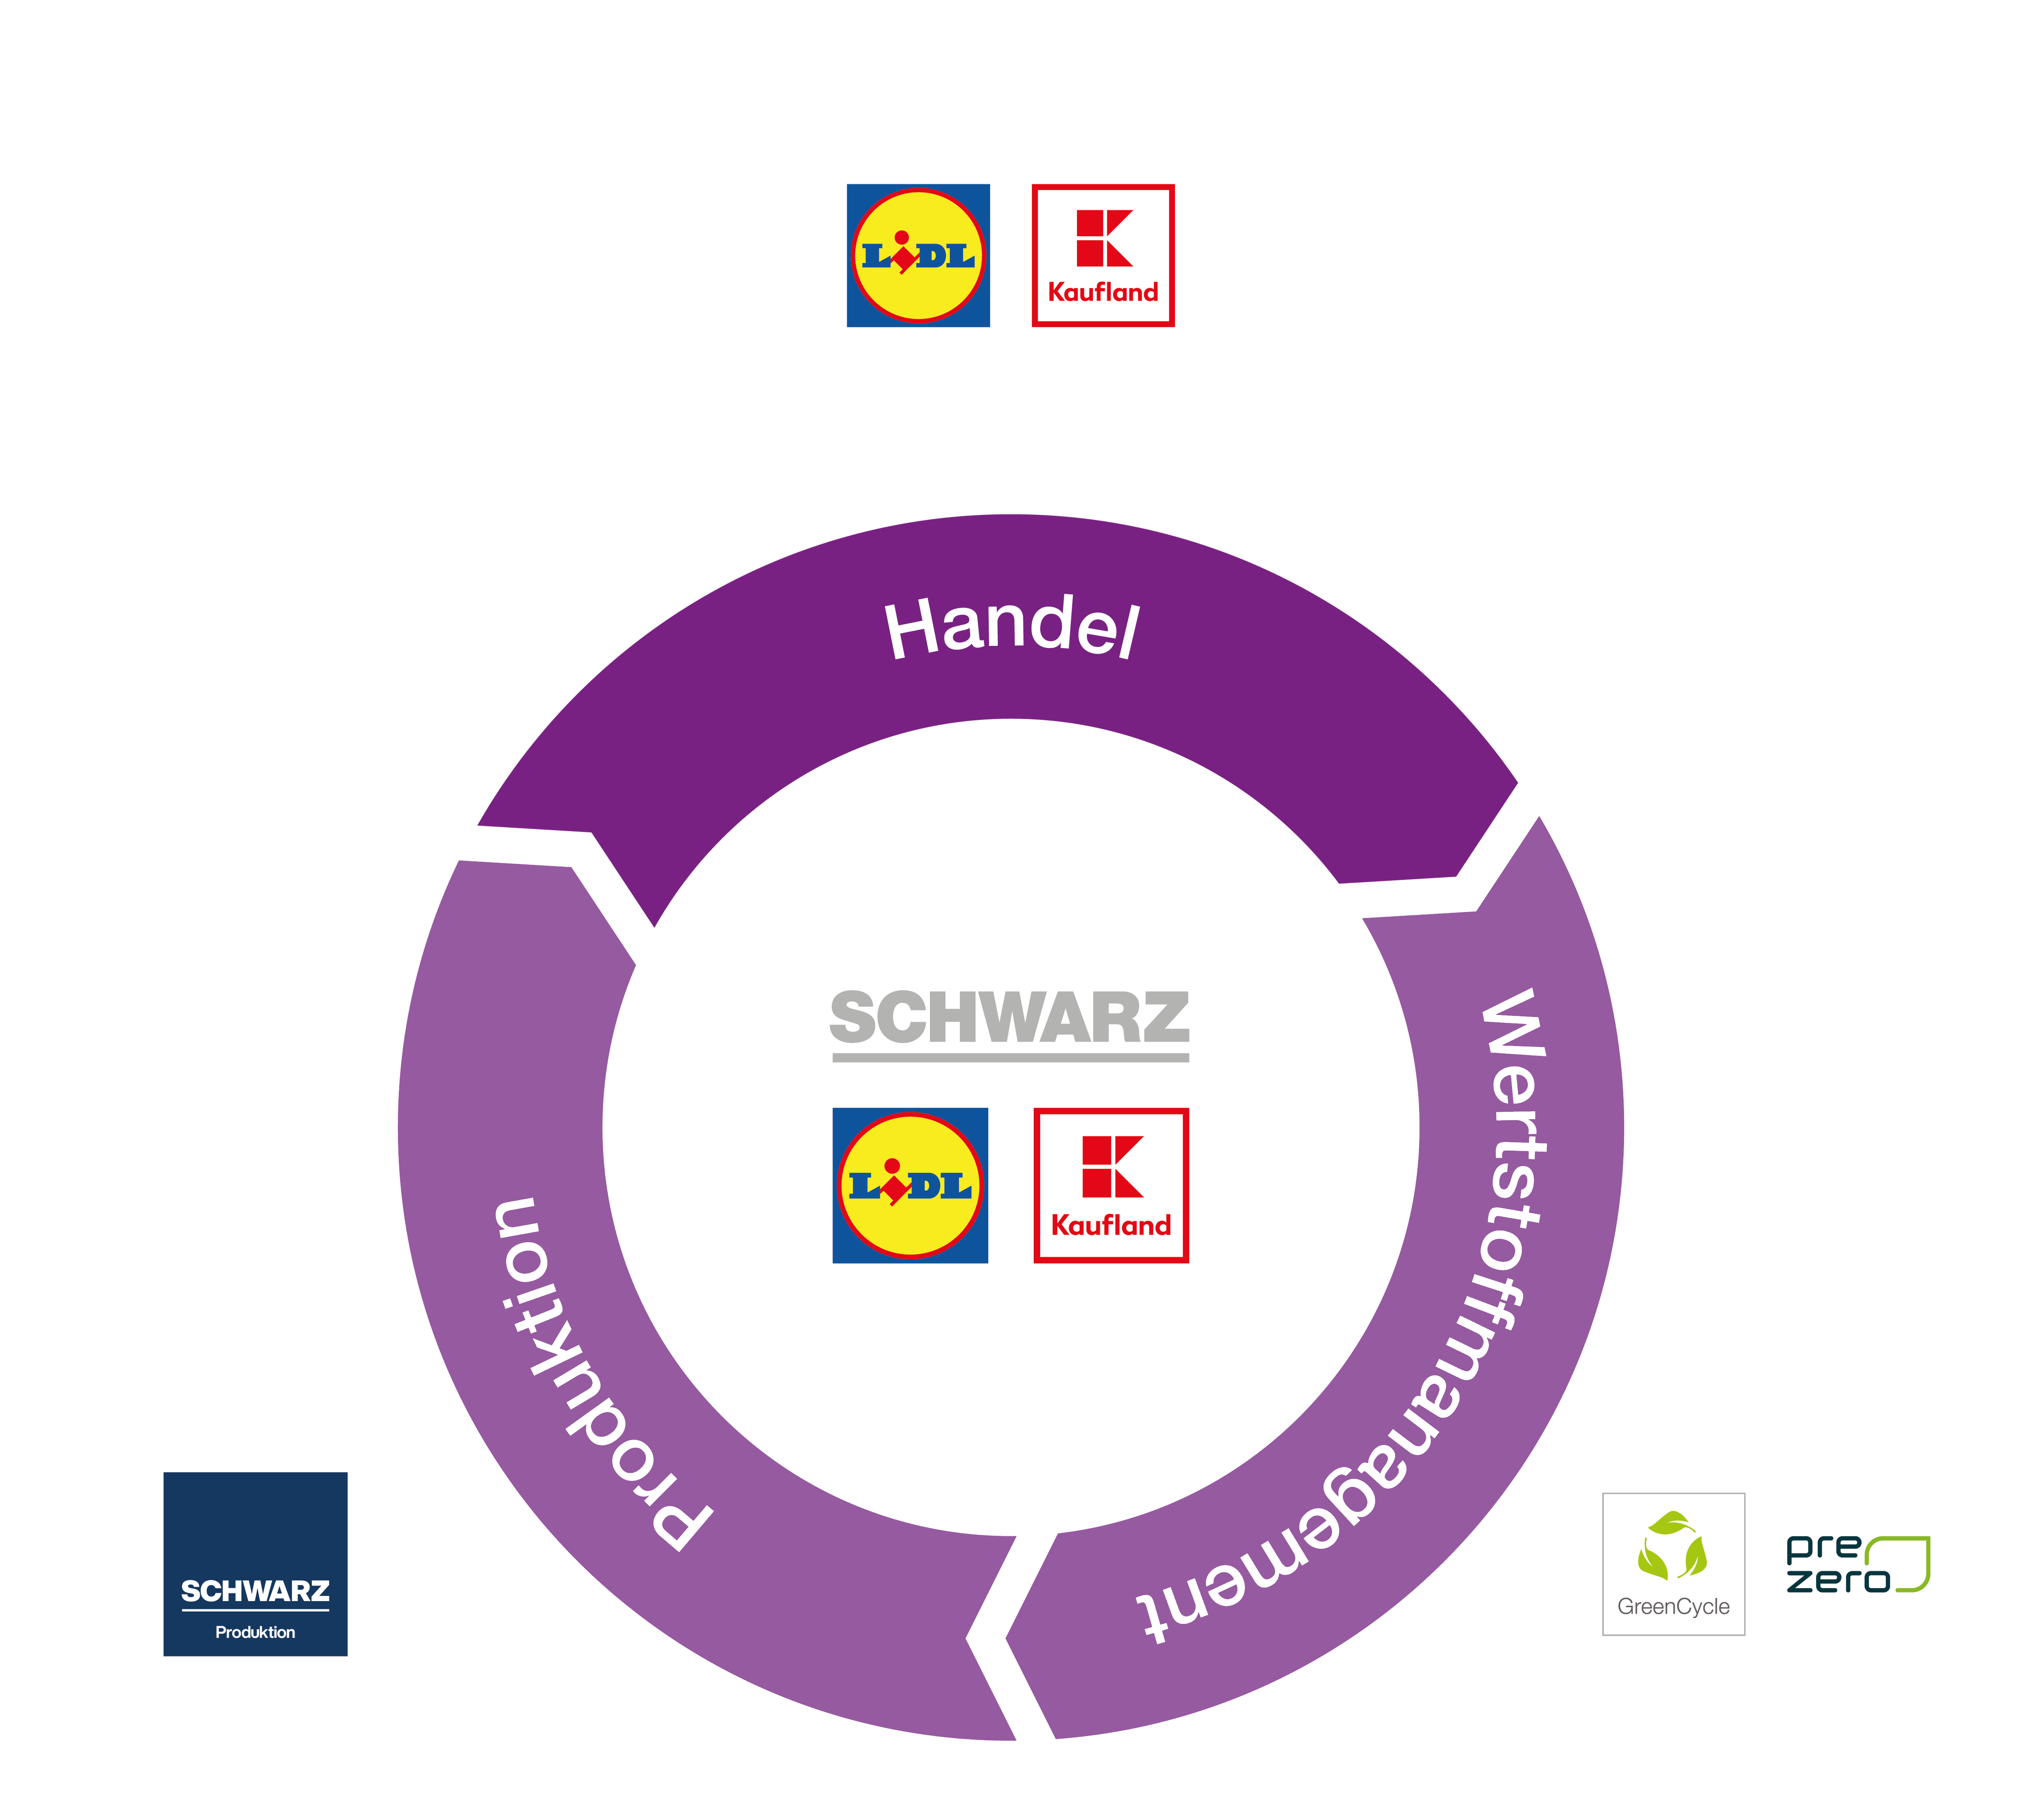
SCHWARZ GROUP
Retail
Retail
Recyclables management
Production

Slide 11
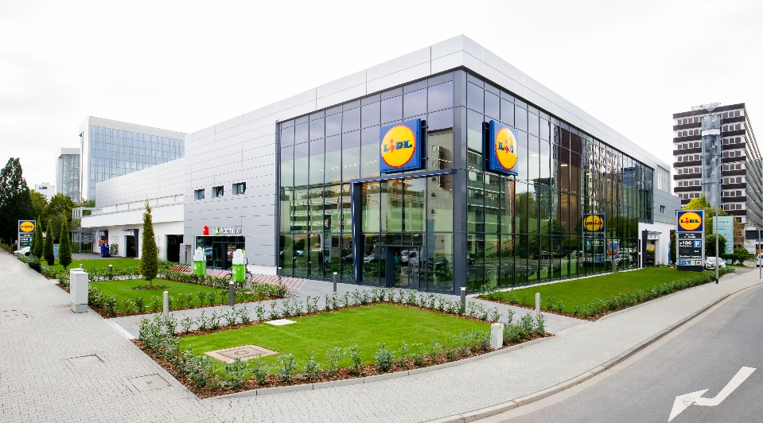
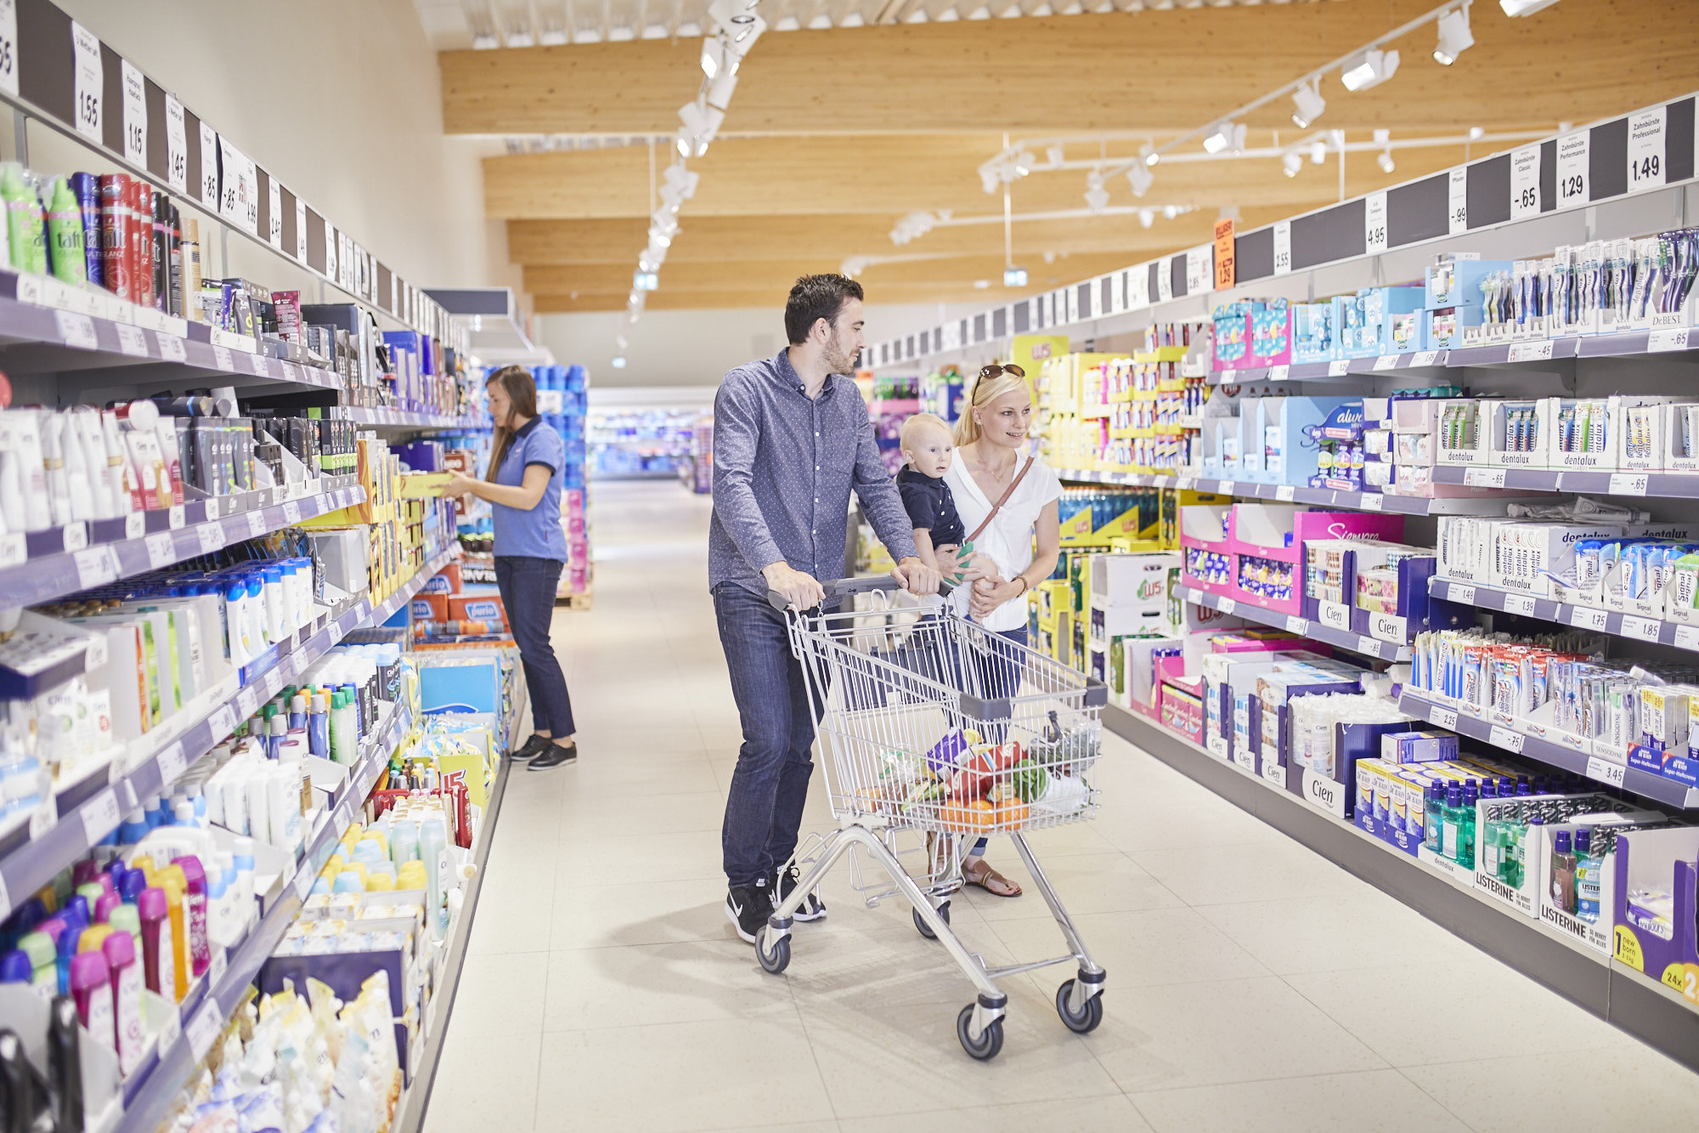

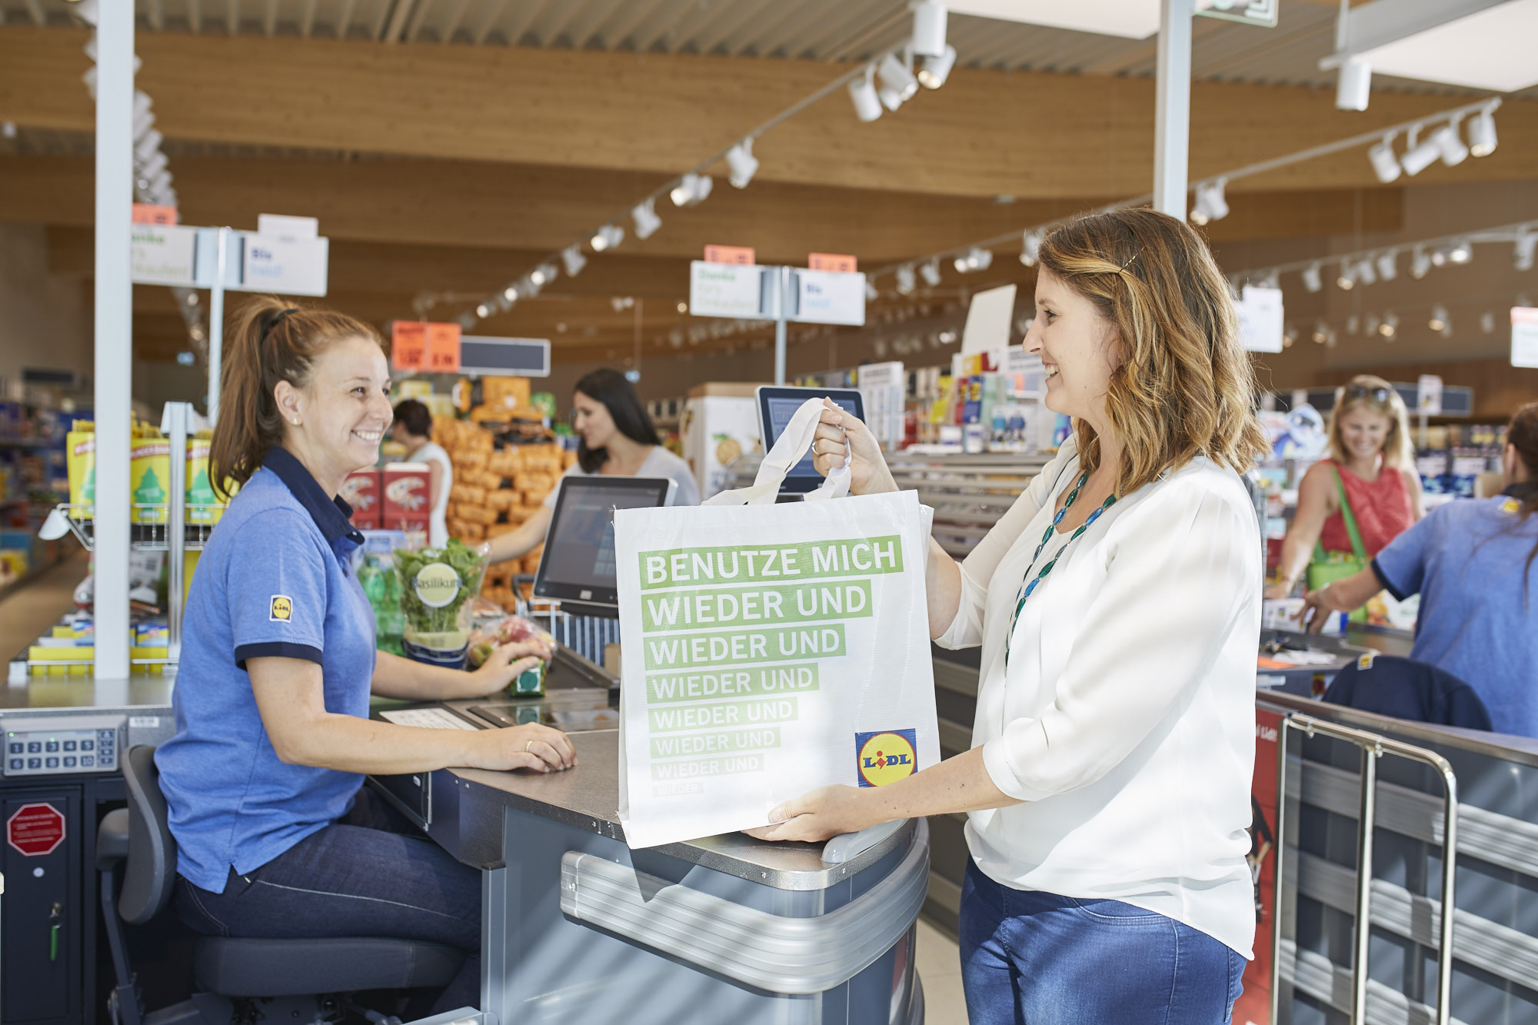
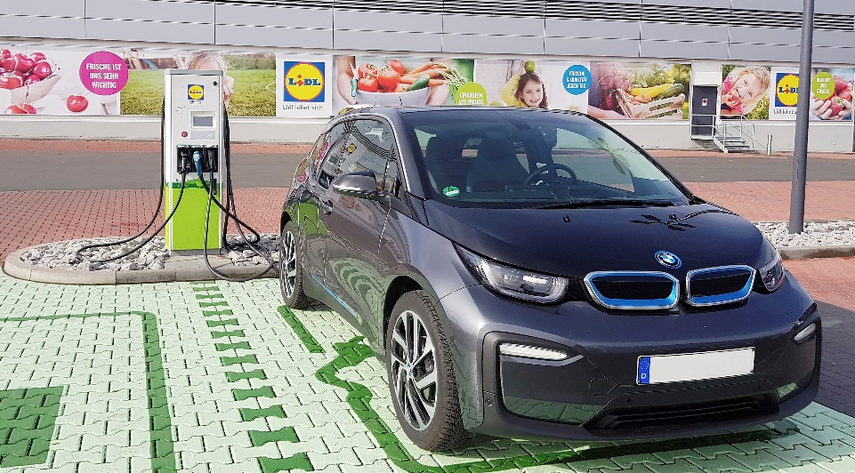

Lidl
Our discounter: Quality for everybody – at an unbeatable price
www.lidl.de

Slide 12
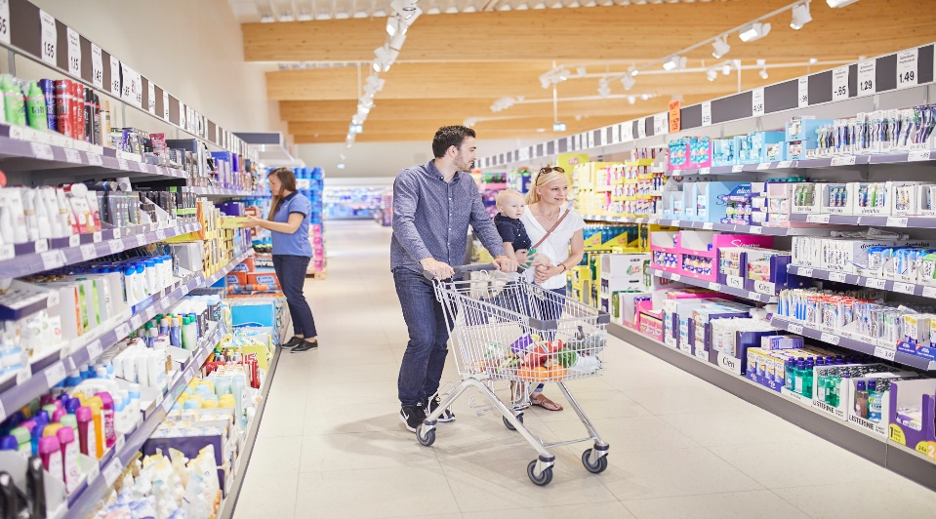

Lidl
Our discounter: Quality for everybody – at an unbeatable price
89.0 bn
10,800 stores
3,200 stores
287,000
(avg.) 1,200 m²
(avg.) 1,800 items
Euro sales
in 33 countries
in Germany
Employees
Sales area
In core assortment
www.lidl.de

Slide 13


Lidl
Lidl Digital: Intelligently link brick-and-mortar retail with online business
www.lidl.de
Brick-and-mortar
Online
Lidl stores
10,800 stores
> In 33 countries
> Wide selection of food / non-food items
Online store / Lidl Reisen / Lidl Plus / Services
Digital services in 12 countries
> 12 million customers
> 30,000 products available online

Slide 14
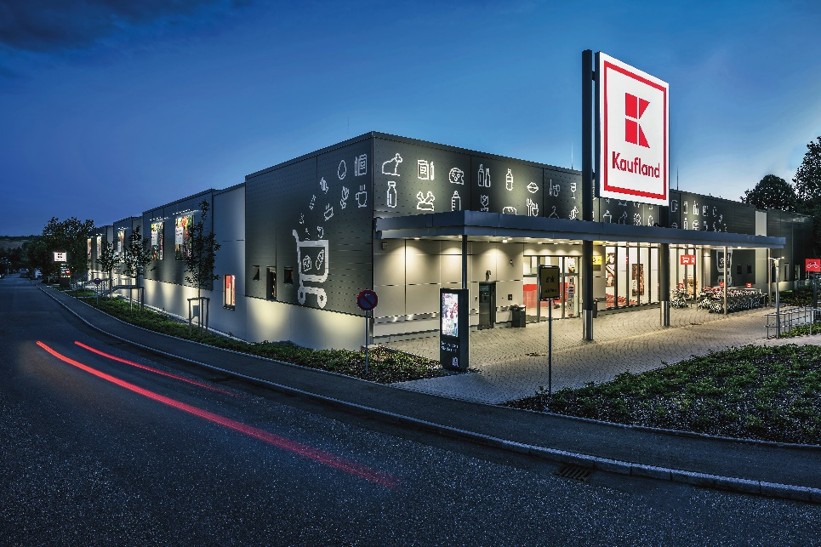
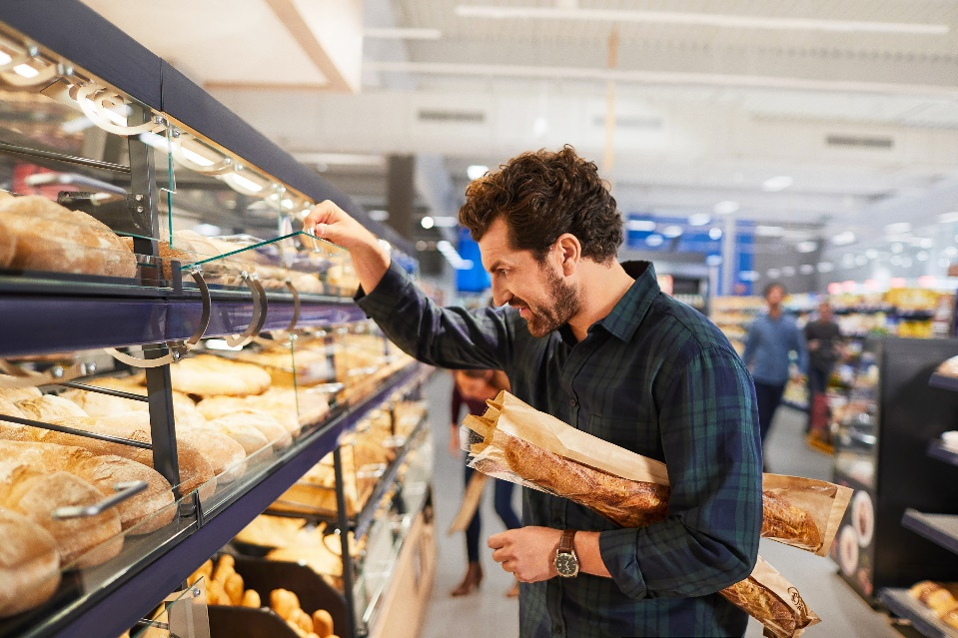

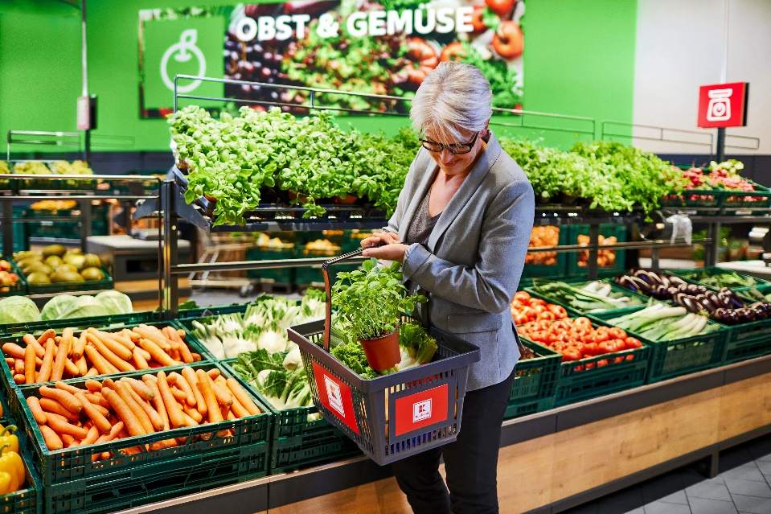
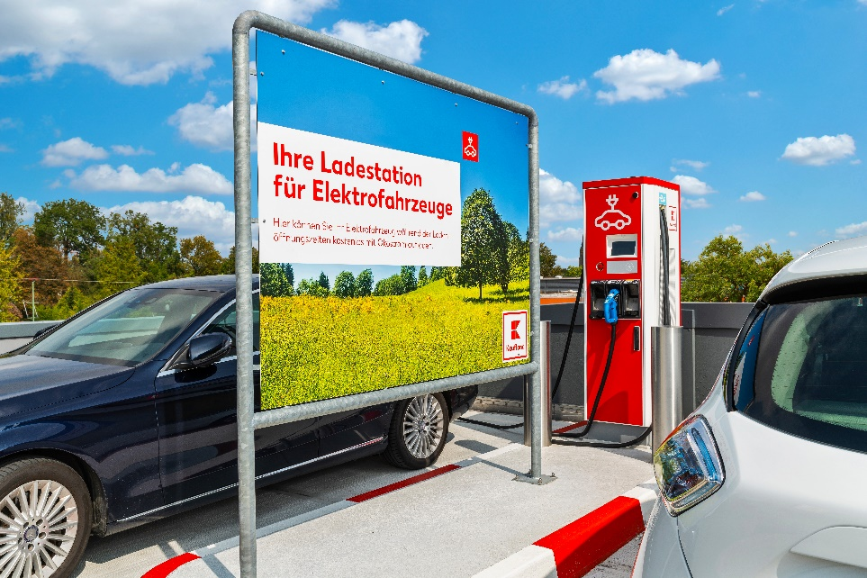
Kaufland
Our self-service department store: The perfect shopping experience
www.kaufland.de

Slide 15
Kaufland
Our self-service department store: The perfect shopping experience
23.7 bn
1,300 stores
670 stores
132,000
(avg.) 4,200 m²
(avg.) 30,000 items
5 meat processing plants
with 200,000 t
Euro sales
in 8 countries
in Germany
Employees
Sales area
In our assortment
In Europe
Annual production volume
www.kaufland.de

Slide 16
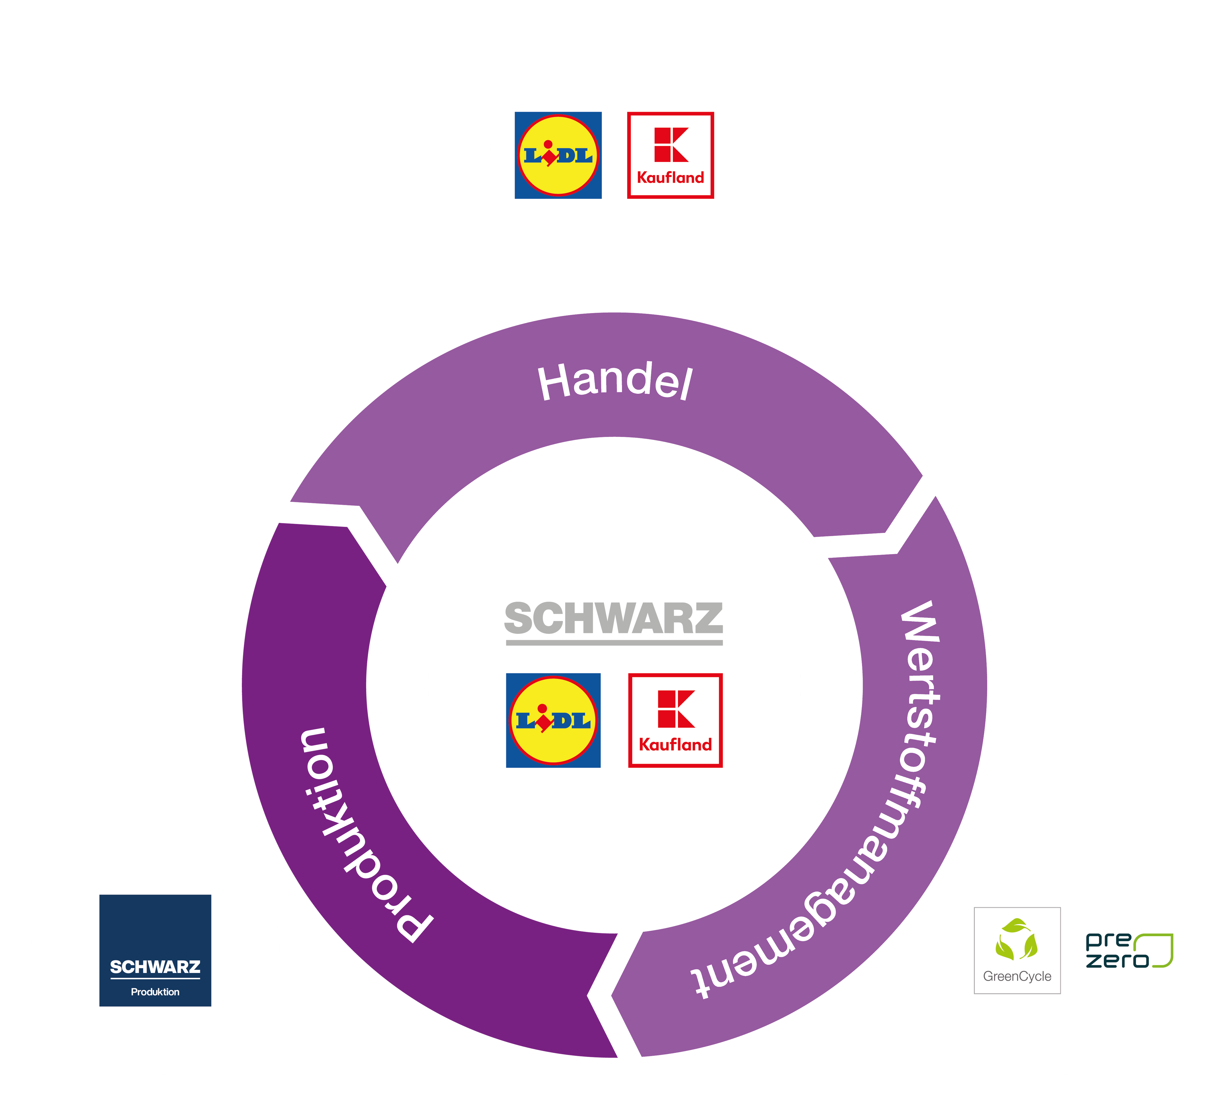
SCHWARZ GROUP
Production
Retail
Retail
Recyclables management
Production

Slide 17



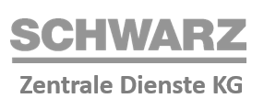







Schwarz Group and Schwarz Production
Schwarz Produktion organizational chart
Produce beverages, e.g. mineral water,
soft drinks, spritzers, sport & diet drinks
Produces various
chocolate bars and dried fruits
Makes baked goods, e.g. bread, rolls and pastries
Produces ice cream, e.g. popsicles, ice cream cones and scoopable ice cream
Performs logistics services at the Übach-Palenberg location
Perform central services, set standards for wider processes and topics

Slide 18



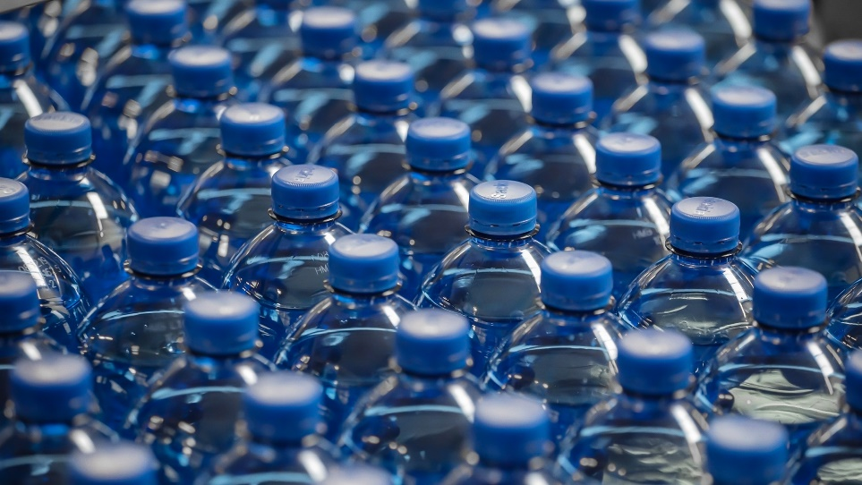



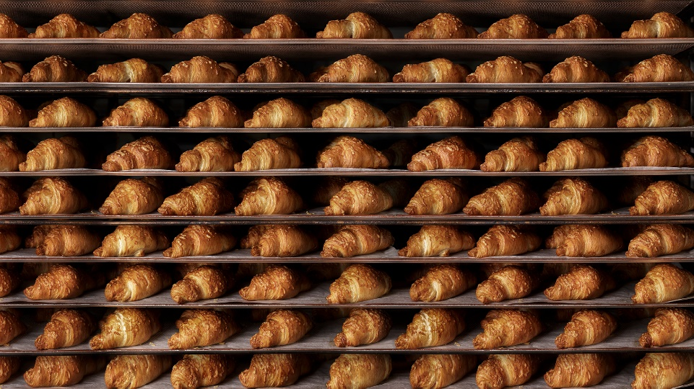


Production
Top quality and supply chain safety
www.schwarz-produktion.com
5
10
4,000
3.7 bn
2 bn
45,000 t
1.4 bn
600 million
Production segments
Production sites in DE
Employees
Beverages filled annually
Single-use bottles recycled annually
Chocolate annually
Baked goods annually
Ice cream annually

Slide 19
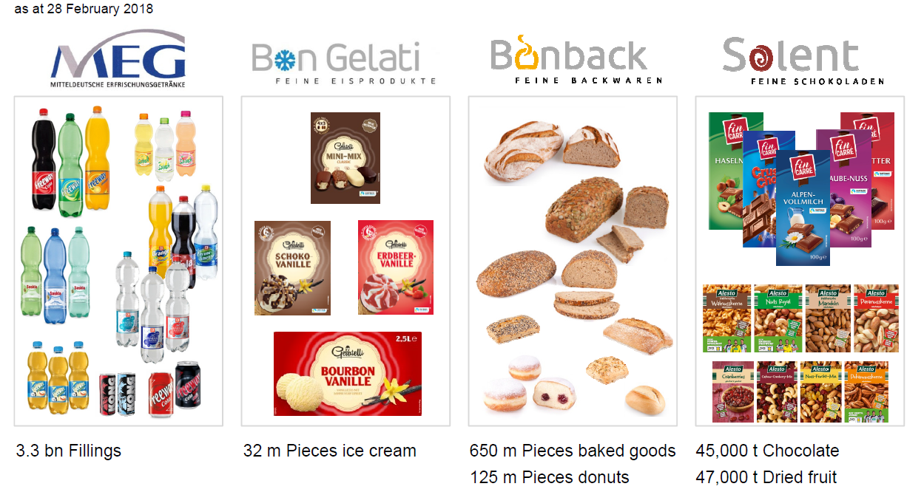
SCHWARZ GROUP
PRODUCTION

Slide 20
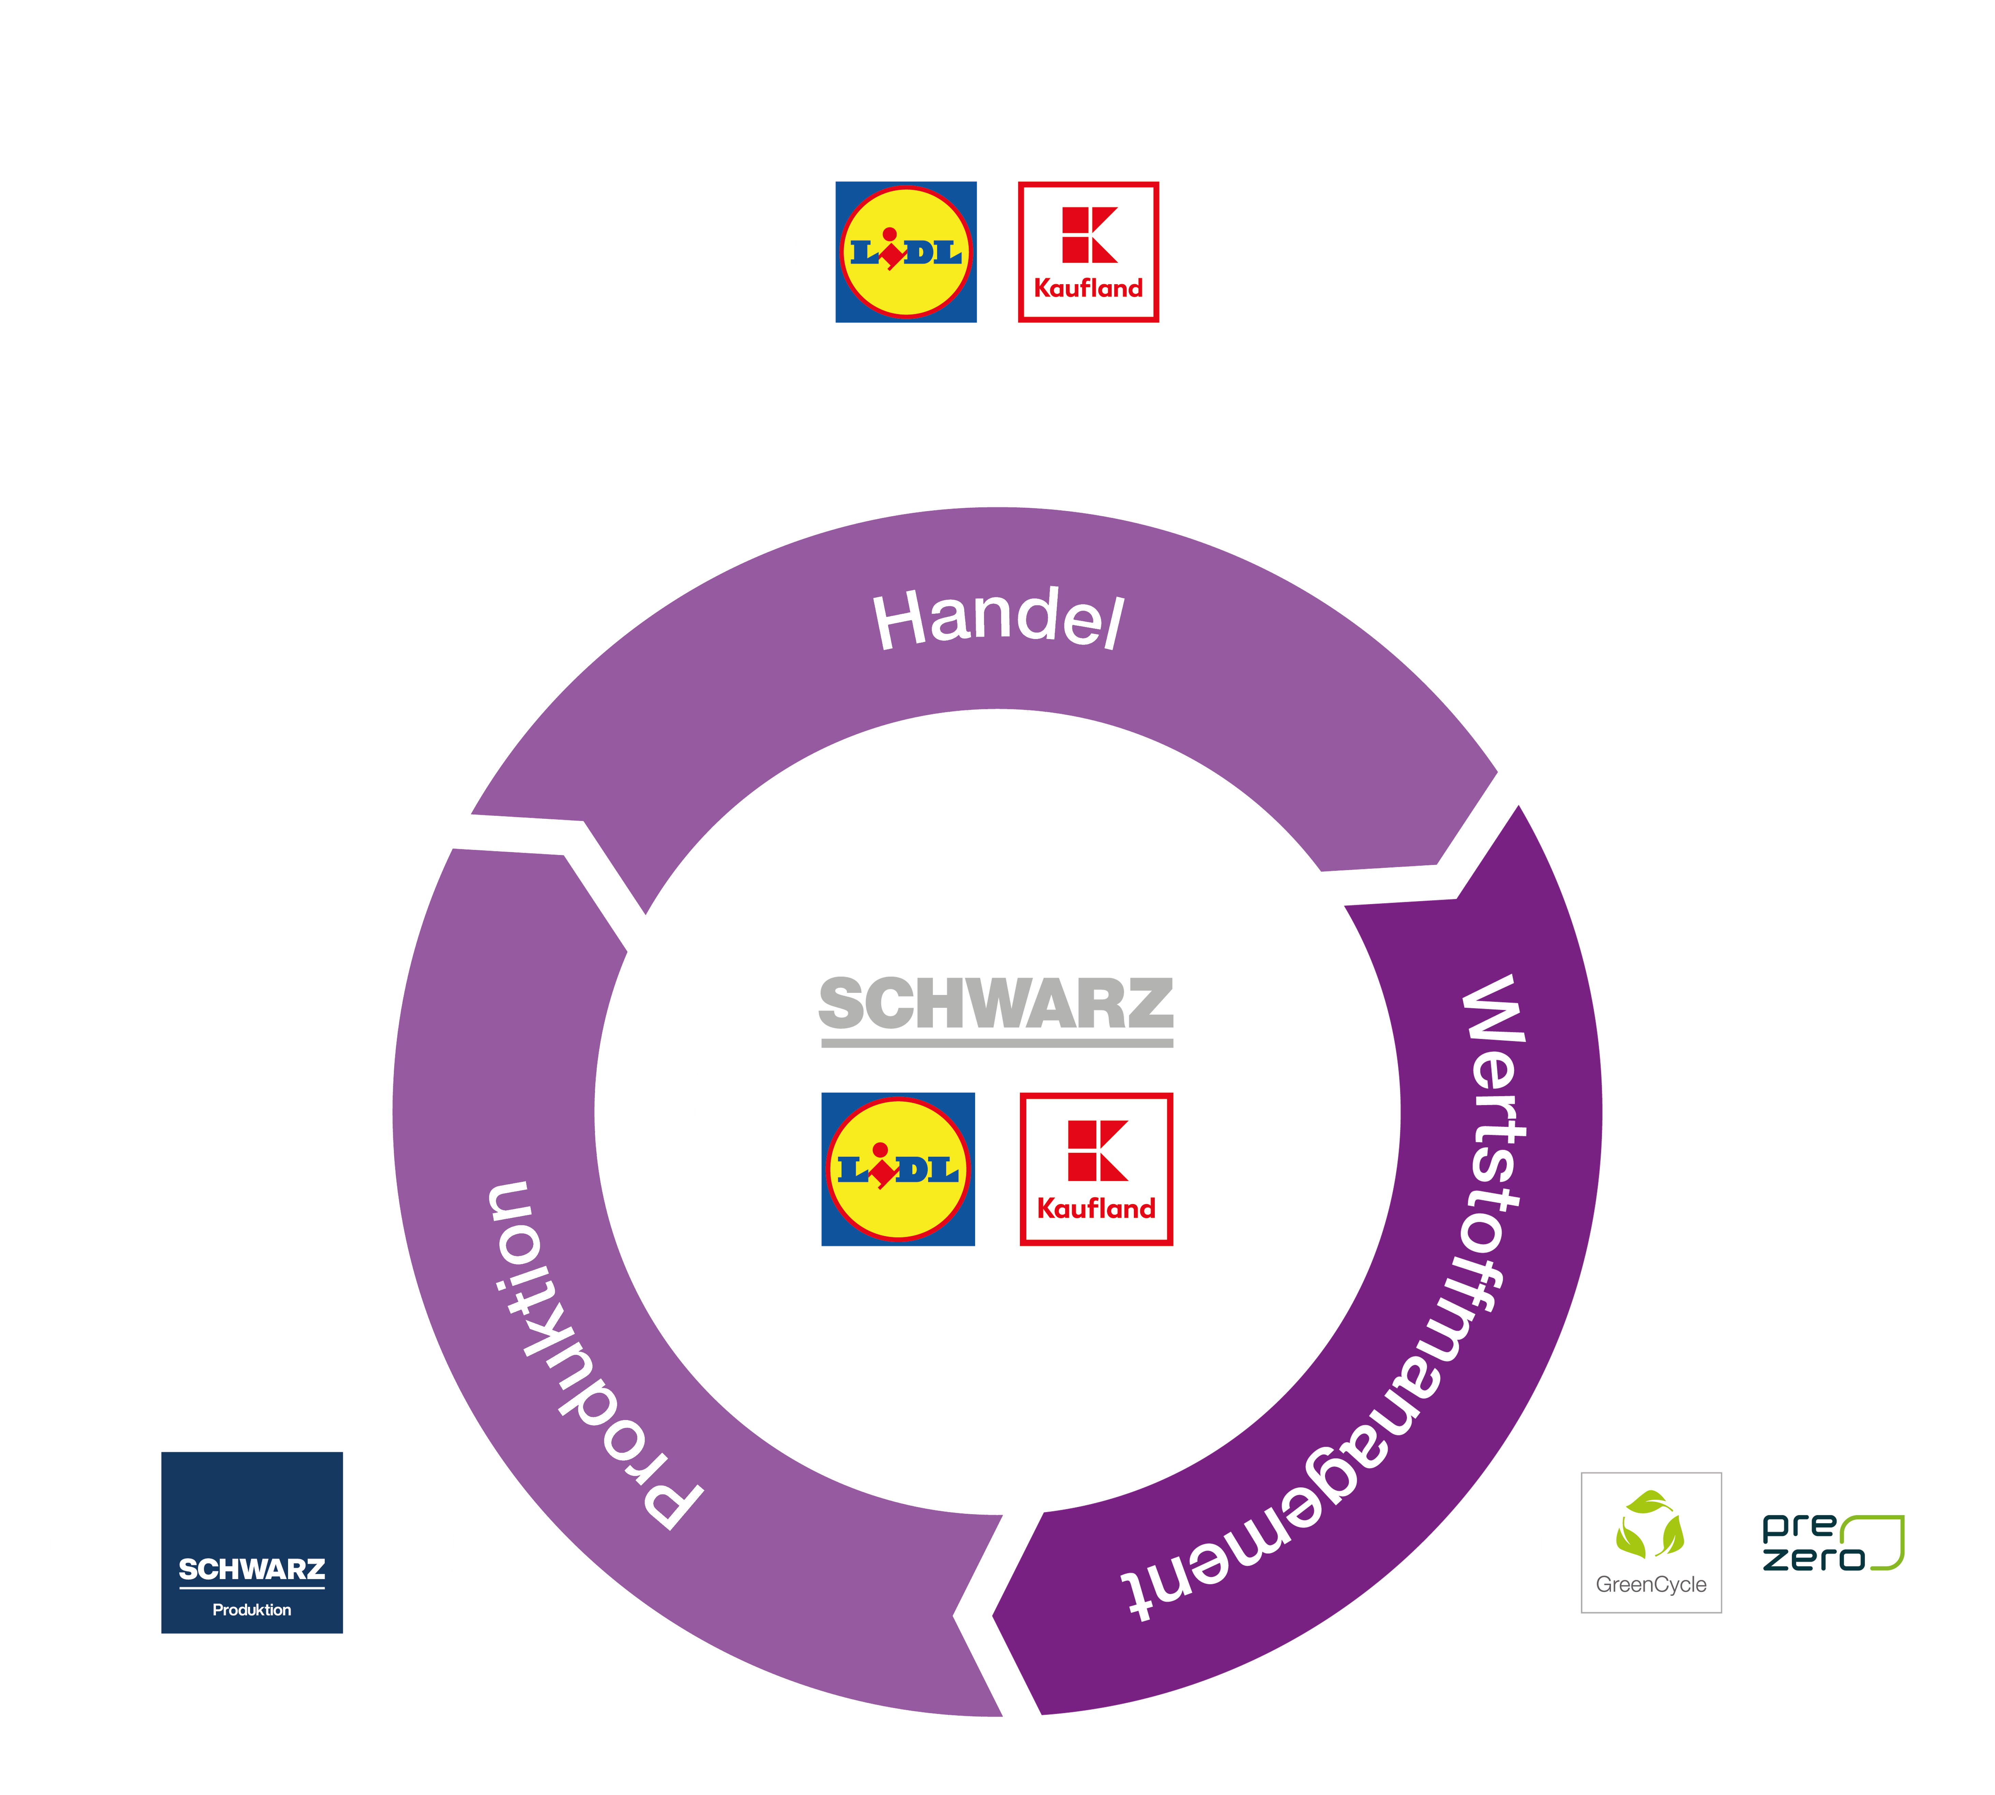
SCHWARZ GROUP
Recyclables management
Retail
Retail
Recyclables management
Production

Slide 21
GreenCycle
The environmental branch
www.greencycle.de
Notes:
GC, alongside Lidl, KL and SDL/SZD, is also part of Schwarz Group
We are a global disposal company and a driver of innovation in the areas of recyclables and energy management, environmental innovation and logistics solutions.
The following represents figures, data and facts as of March 2020.

Slide 22

About GreenCycle
Corporate divisions
Pallet pool
Innovative reusable carriers for retail and industry.
With PreZero, one of the leading disposal services in Germany.
The dual system as strategic link between manufacturer and disposal agent.
Energy and environmental innovation
Internal service provider and energy management consultant in the Schwarz Group.
22
Notes:
Company active around the world in 3 business divisions
Focuses on disposal and recycling
Energy management and environmental innovation
Logistics solutions, operates pallet pool

Slide 23
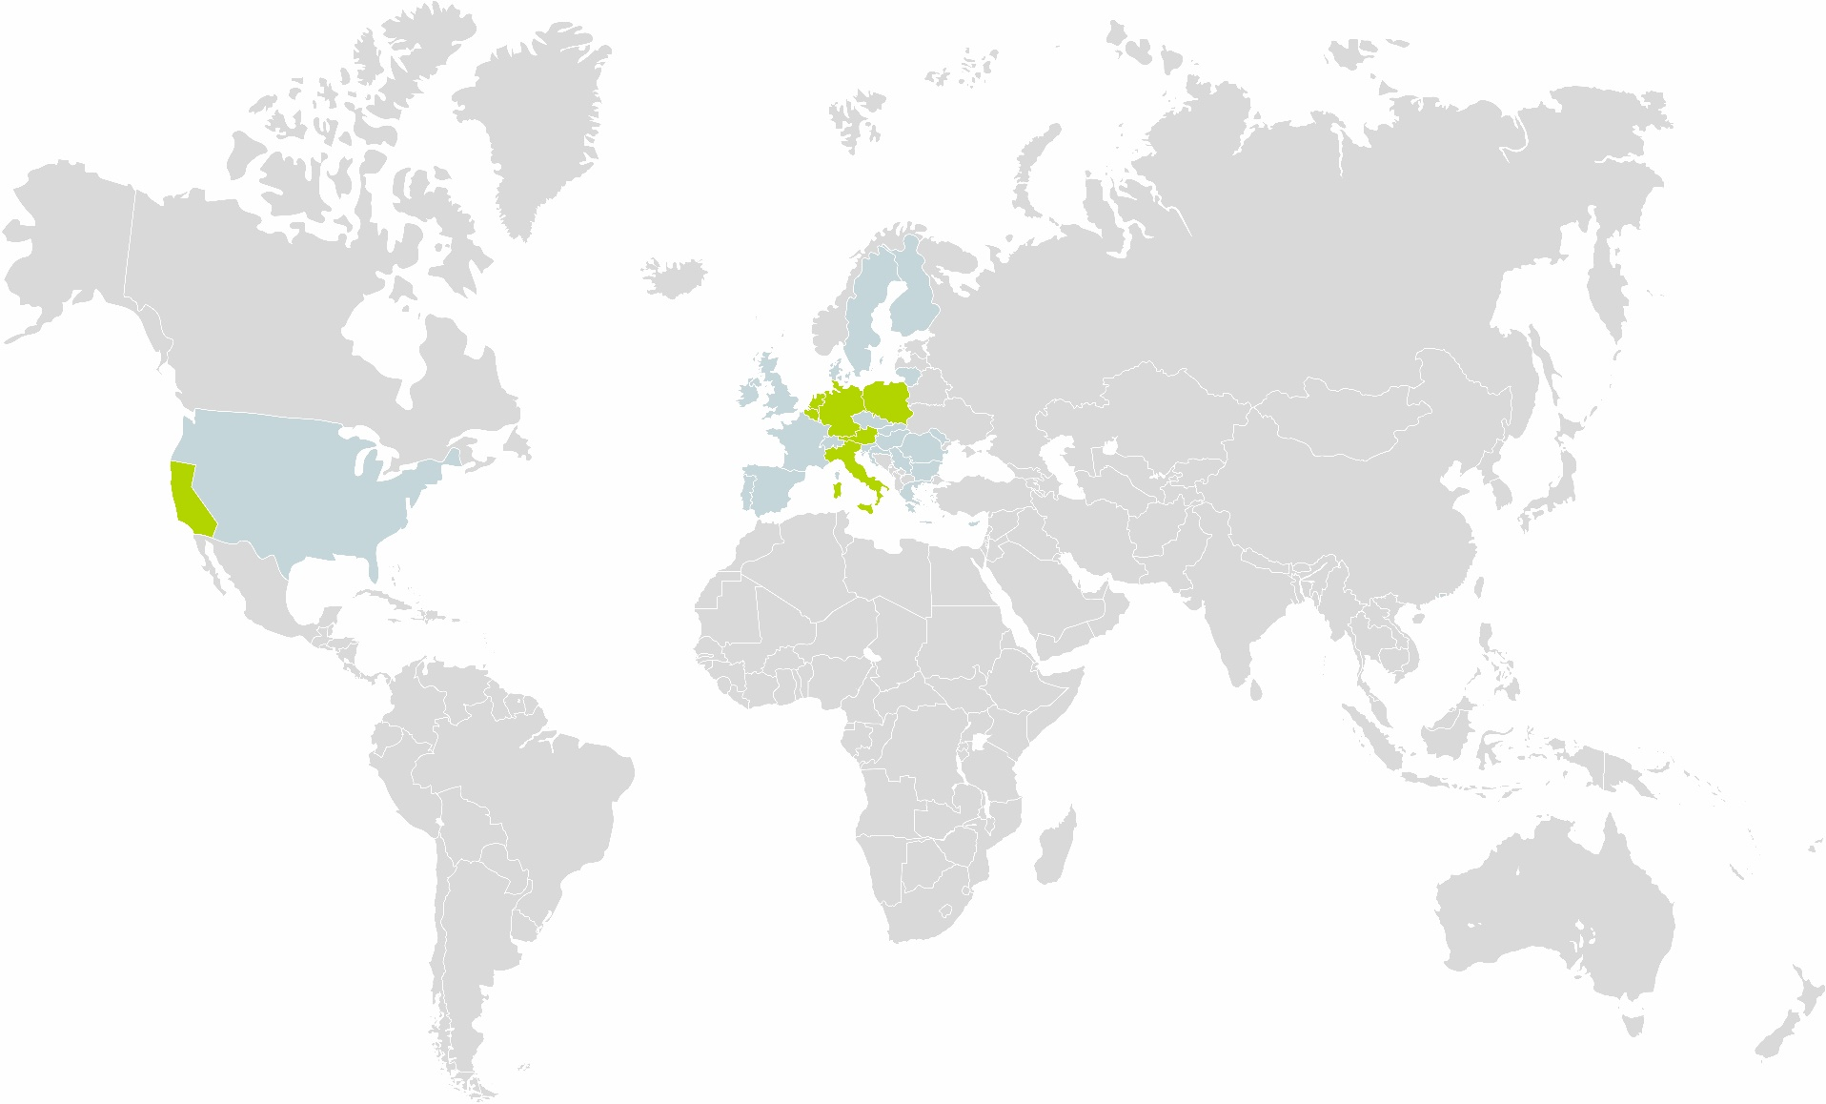
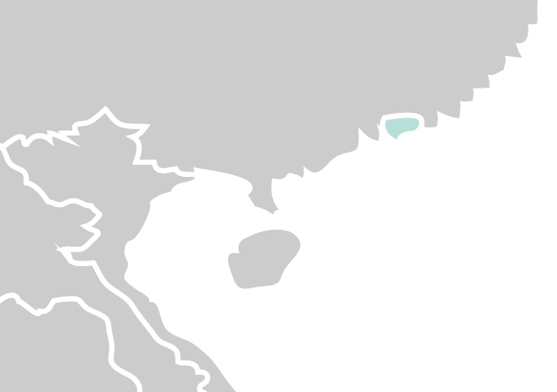
GreenCycle – figures
strategic
operating
In Europe and around the world
approx. 500 M. EUR revenue in 2019
54 locations in DE 30 locations in PL 1 location each in NL, BE, IT, AT, HK 2 locations in the USA
approx. 3,600 employees
1,100 trucks
€
US
Hong Kong
23
Notes:
With the above, we made 750 M. EUR in sales in 2019
We are active worldwide. On the one hand, strategically in every country where Lidl and Kaufland are also active (shown here in blue), as we operate their recyclables management;
On the other hand, on the operational level with facilities: in other words, disposal operations, sorting, or producing recycled products
In the USA as well, we started business operations in California with the acquisition by RMG in 2018.
Our office in Asia represents us in an important market for recyclables

Slide 24
SCHWARZ GROUP
Schwarz Zentrale Dienste &
Schwarz Dienstleistungen
Retail
Recyclables management
Production

Slide 25


Schwarz Services
Our service provider for the divisions
Focus on administrative functions in the Schwarz Group
Focus on operational functions in the Schwarz Group
Controlling
Auditing
Procurement
Mobility
Finance
Taxes
Real estate
Production facilities
In-house consulting
Corporate organization
IT
Restaurant operations
Staff
Insurance
Accounting
Administration
Legal & compliance
Corporate communications / CSR
Notes:
SDL: Administrative functions; we will take a closer look at SZD again
We have already taken a look at production, now we'd like to present the other elements of SZD:

Slide 26
Schwarz CENTRAL SERVICES

Slide 27
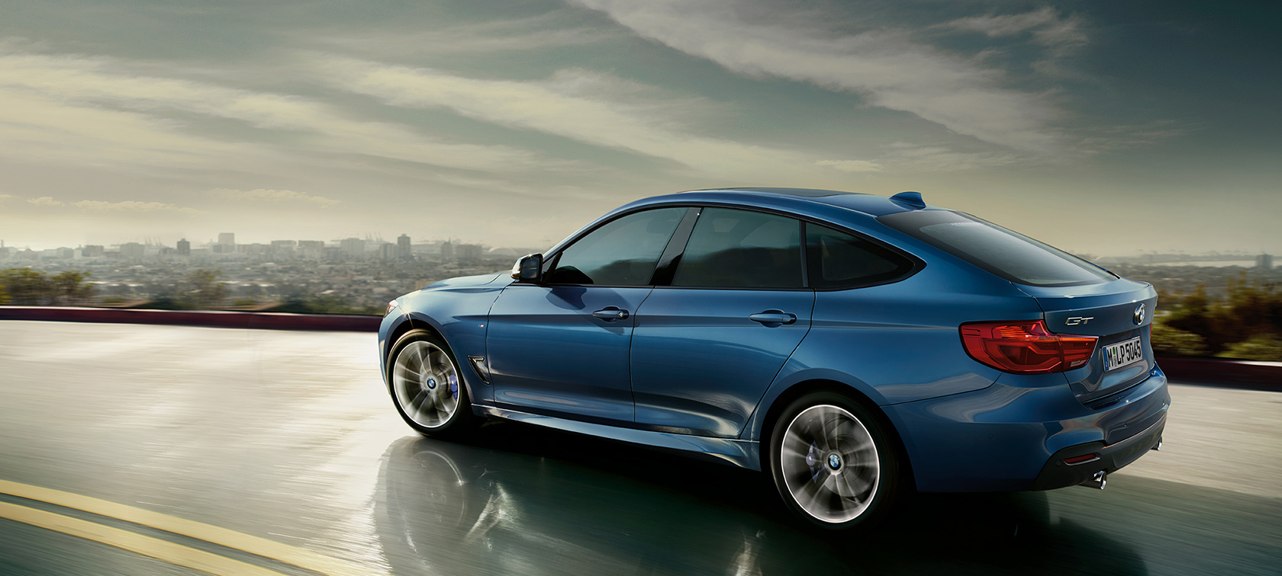

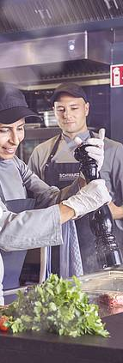
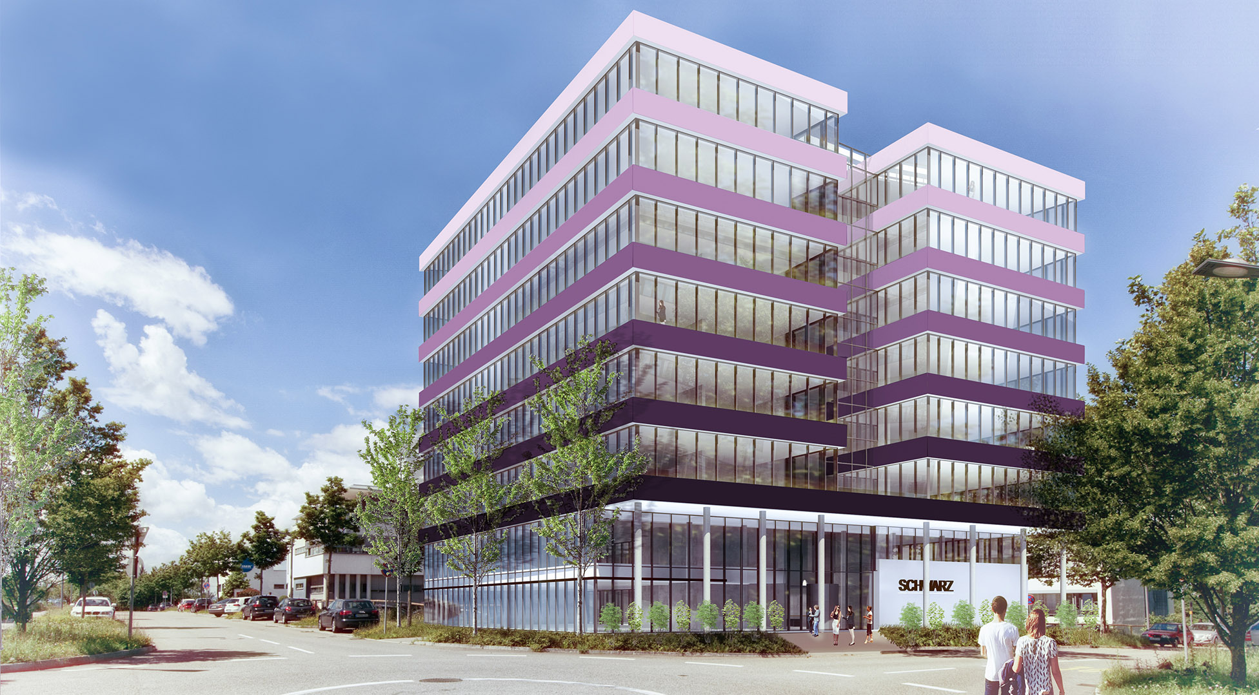
Schwarz central service
SMS, SBES, SRB, SIS

Slide 28






Schwarz central service
Schwarz Mobility Solution (SMS)
SMS
Vehicle fleet
Alternative mobility concepts
Org. / travel
Top service
Transport service
Notes:
Vehicle fleet: Traditional fleet services such as vehicle procurement, determination of company car regulations, OWI service, fuel card management, service hotline and on-site service from central location, organization of vehicle logistics, from BMW to meeting points to company car drivers, etc.
Alternative mobility concepts: everything concerning mobility except for company cars, ready4green (bike, bus, rail, ride-sharing app, etc.), in-country support, etc.
Organizational: see key points + travel (introduction of an online booking engine and Group-wide standardization of travel management)
Transport service: 15 drivers
Top service: as the name implies ;-)

Slide 29
Schwarz central service
Schwarz Procurement (SBES)
Strategic procurement of all products and services
for internal needs within the Schwarz Group.*
* Defined exceptions: Banking services, properties and real estate, transport services - merchandise

Slide 30



Schwarz central service
Schwarz Immobilien Service (SIS)
160
Employees
540,000 m² floor area
140
Building
Notes:
Construction:
- Construction service providers in various projects for Lidl, Kaufland, SDL/SZD
- Responsible for planning and constructing management and auxiliary buildings in the HN/NSU region
- Currently: New construction of Bad Wimpfen Lidl service, modernization of Olgastr. Kaufland, Wilhelmstr. student housing 27 in HN, etc.
Facility Management:
- Operation and management of real estate
- Building blocks: Safety and fire prevention, vending supplies, maintenance, postal service, receiving services, cleaning services, service provision for office equipment
- Planning/measuring of required floor space
- Organization for relocations

Slide 31
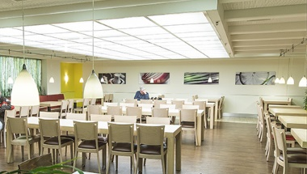
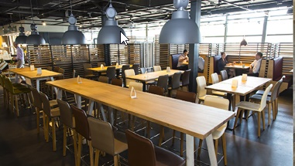
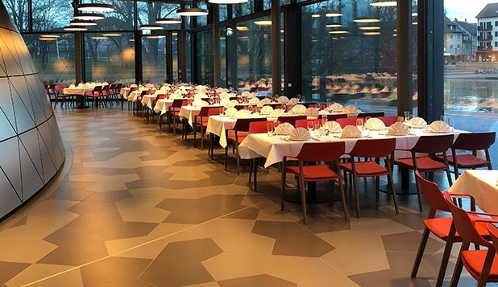
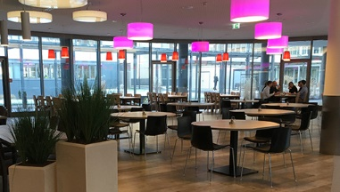
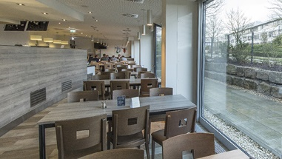
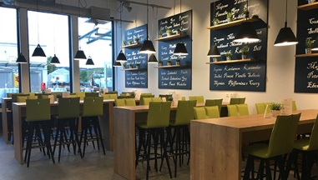
Schwarz central service
Schwarz Restaurant Betriebe (SRB)
7 restaurants operated in-house
7,500 customers per day
200 employees
2,000 seats
5,000 entrees per day
7 million in revenue
Notes:
Restaurants in-house, i.e. with own staff

Slide 32
SCHWARZ IT KG

Slide 33

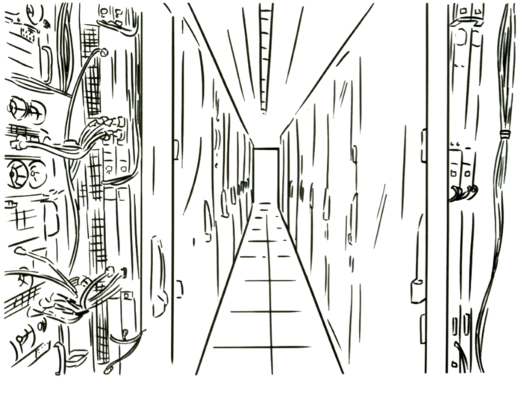



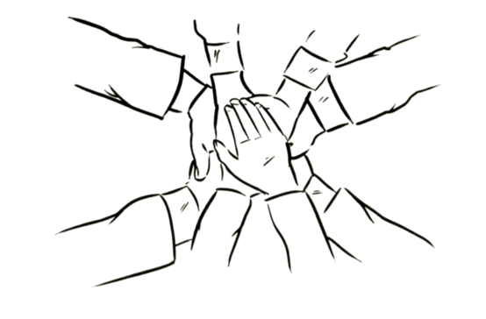


SIT TimeLine
Schwarz IT Infrastructure & Operations Services
Governance &
IT Architektur
SITIOS
SIT KG
- ONE IT -
SIT GmbH & Co.KG
SIT
1.5
07/2015
10/2017
SBIT
05/2019
09/2018
10/2016
Schwarz Business IT
Notes:
01.07.2015: Foundation of SITIOS (=Schwarz IT Infrastructure & Operations Service) -> bundling of infrastructural issues
01.07.2016: Foundartion of SBIT (Schwarz Business IT) -> bundling of business issues related to SDL/SZD
01.10.2017: Foundation of Schwarz IT (Merger of SBIT & SITIOS)
01.09.2018: Bundling of IT-Governance-Issues (also Lidl/Kaufland) in SIT
01.01.2019Schwarz IT GmbH & Co. KG becomes Schwarz IT KG
1.5.2020: One IT for Lidl, Kaufland, SDL/SZD

Slide 34






Creating one IT
Since May 2019
Lidl Digital
Lidl
Kaufland
Produktion
SDL / SZD
Schwarz IT
Business Consulting
Support
Development
Governance & Architecture
Infrastructure
Notes:
01.01.2019Schwarz IT GmbH & Co. KG becomes Schwarz IT KG
1.5.2020: One IT for Lidl, Kaufland, SDL/SZD

Slide 35
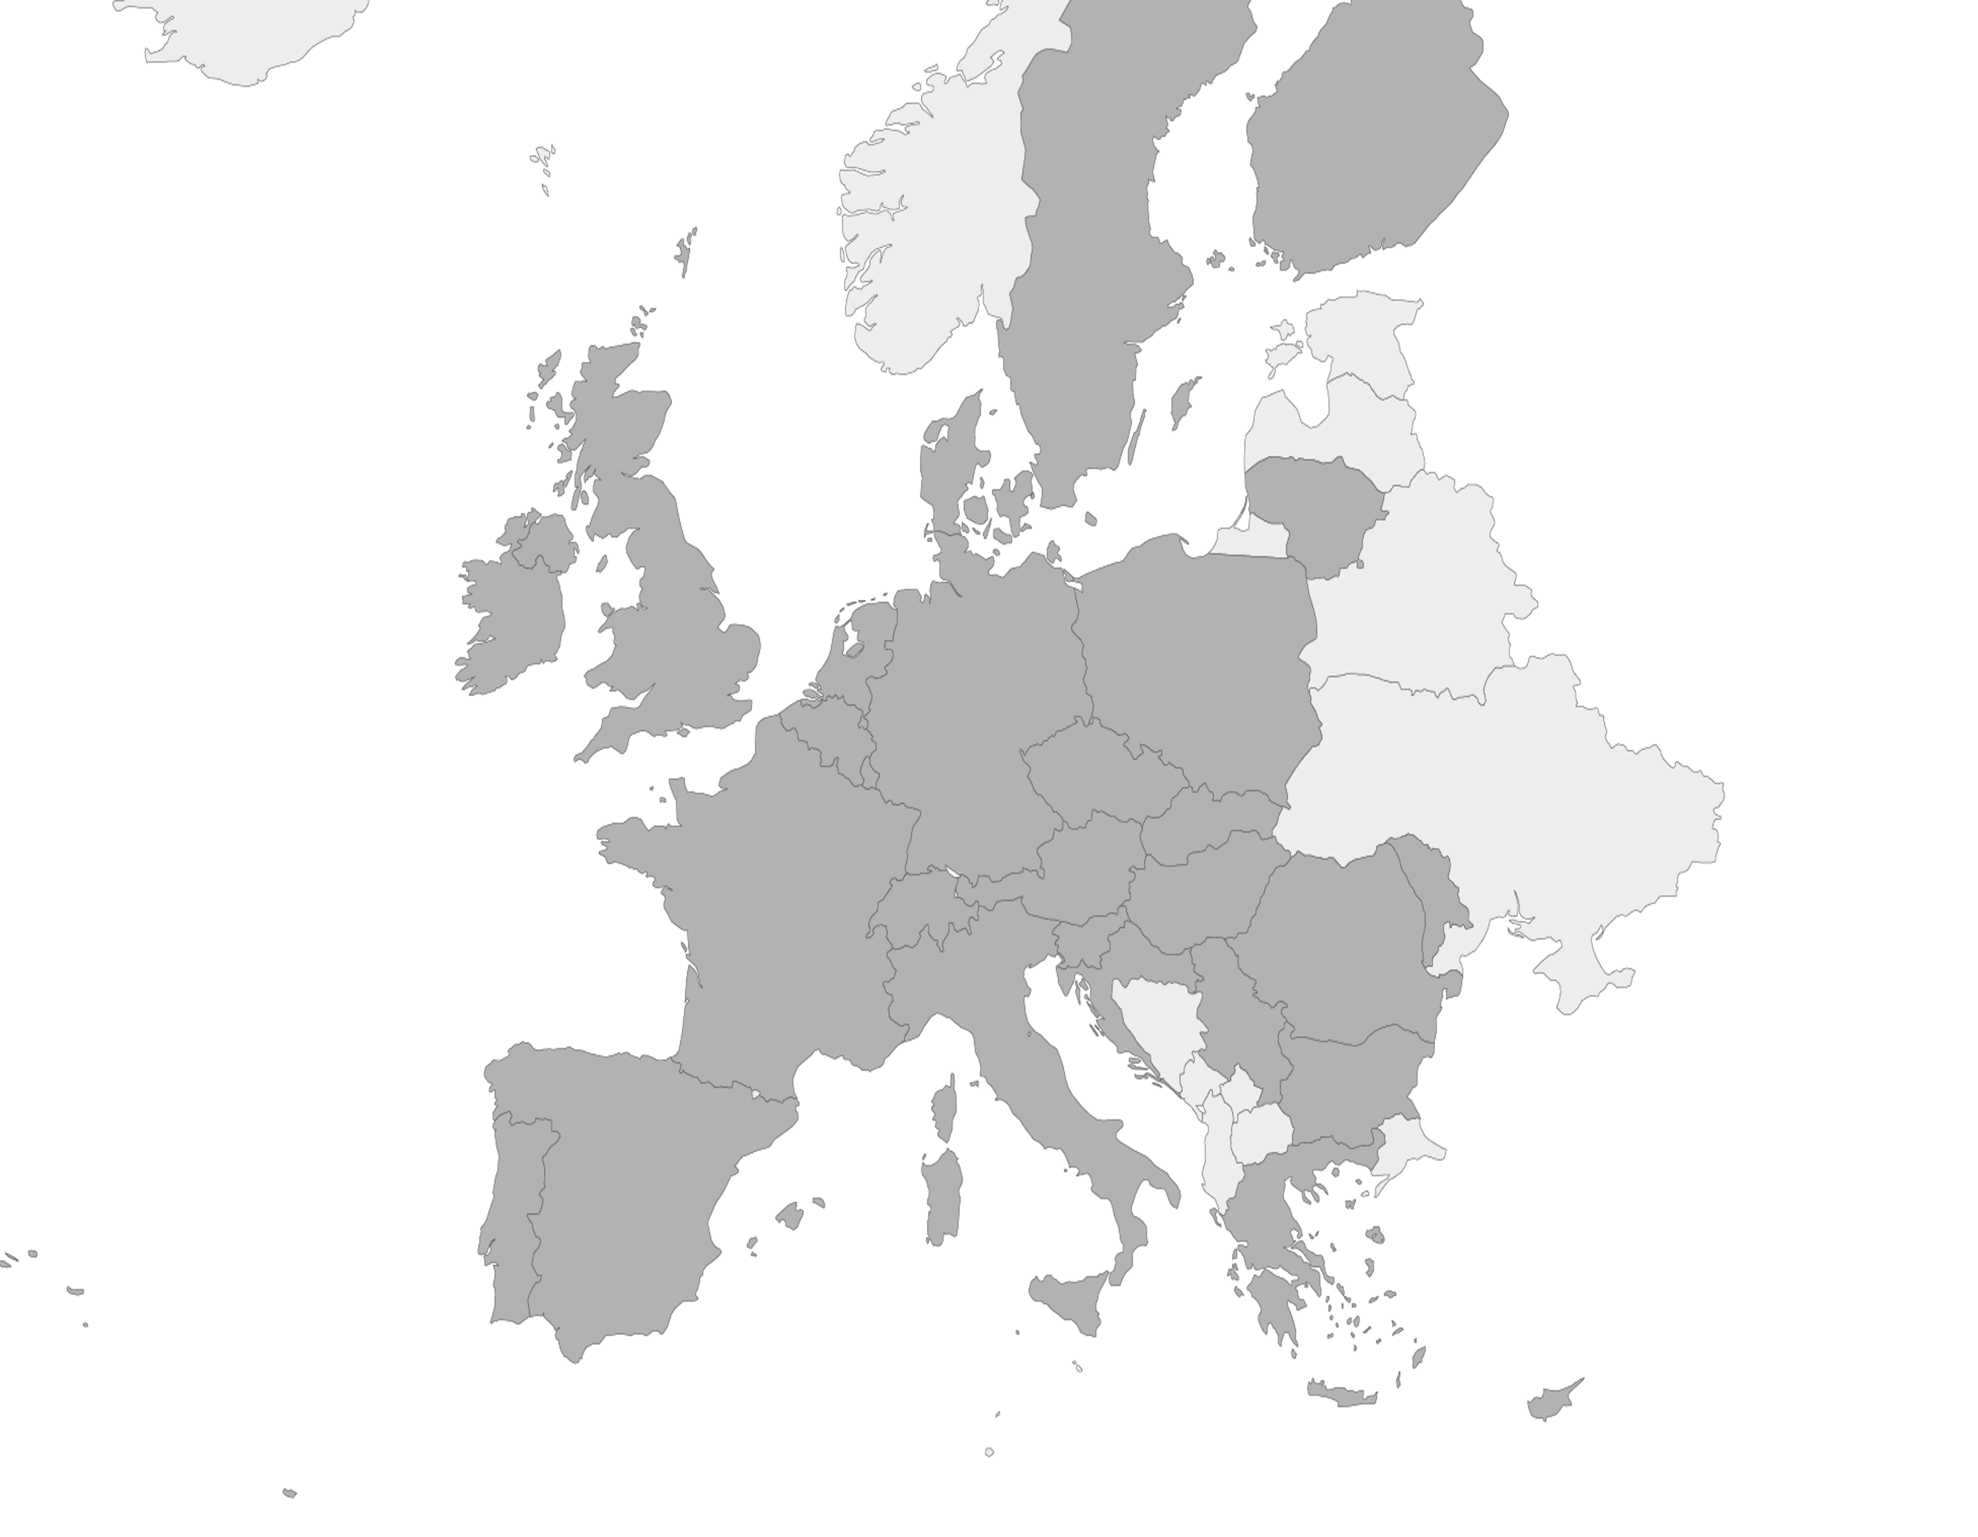
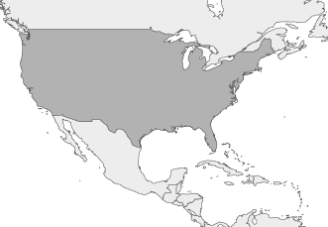




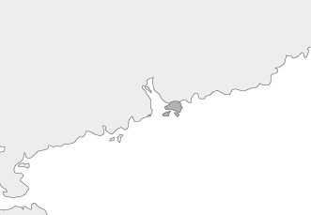
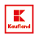


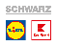





Our customers
Finland
We are the central IT service provider for...
USA
Estonia
Sweden
(expansion)
Latvia
(expansion)
Denmark
Lithuania
Northern Ireland
Hong Kong
Ireland
Great Britain
The Netherlands
Production
Retail
Poland
Belgium
Germany
Recyclable materials
Luxembourg
Neckarsulm
Czech Republic
Slovakia
Switzerland
Austria
Hungary
Moldova
France
Slovenia
Romania
>12, 100
30
30
>429,000
Stores
Sorting & recycling facilities
Countries
Employees
over 160,000 of them in DE
Croatia
Serbia
Italy
Bulgaria
Spain
Greece
Portugal
Malta
Republic of Cyprus
Notes:
Already shown in the first employee event in BG
We are the central IT service provider for the Schwarz Group. This means that we are responsible for the IT of the number four in global retail, with over 12,100 Lidl and Kaufland stores in more than 30 countries. We also provide IT support for the production facilities and our recycling company Greencycle with Prezero, who have over 30 sorting and recycling plants. In all, we take care of the IT for over 430,000 employees throughout the Group. That's who we are, the employees of Schwarz IT and all the local IT units in the Schwarz Group. All together, we are ONE IT.

Slide 36










Shoring CENTER SIT
Current IT Shoring Map
Poland
APEX Development
MIS
EDI Support Center
Sharepoint Support
France ESB development Application development
USA
Support
Global Business Support
Czechia
POS Systems
Hong Kong
Business Application Monitoring & Operations
11 Shoring countries with 26 Shoring activities
Romania
E-Commerce
6
Solution Center
1
Virtuelles Team¹
Bulgaria
KIS Hub
E-Commerce
Delivery Center
19
Spain
SAP Support
Lidl Payment Security
Salesforce Support
Salesforce Appl. Development
E-Commerce
Technical Consulting
Solution Center
Delivery Center
Greece
Support WWS/LSYS
Product management WaWi/FWWS
APEX Development
Application development WWS
Support
Serbia
SAP Hub
< 5 Mitarbeiter
5 - 11 Mitarbeiter
> 11 Mitarbeiter
Anstieg Mitarbeiter bis Ende 2019 über 50%
¹ Virtuelles Team: Sharepoint Betrieb

Slide 37
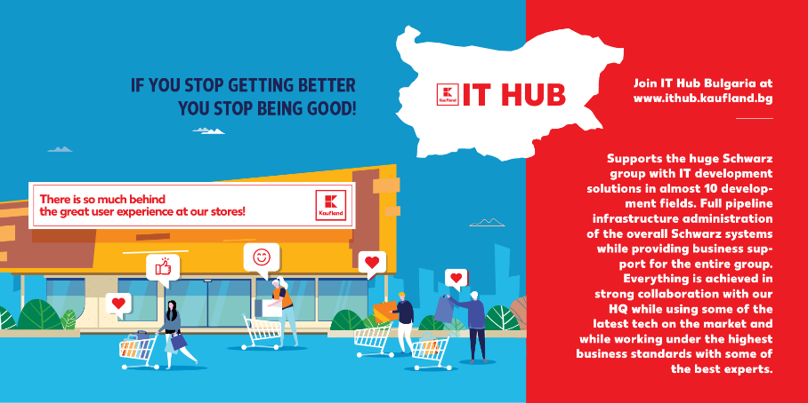
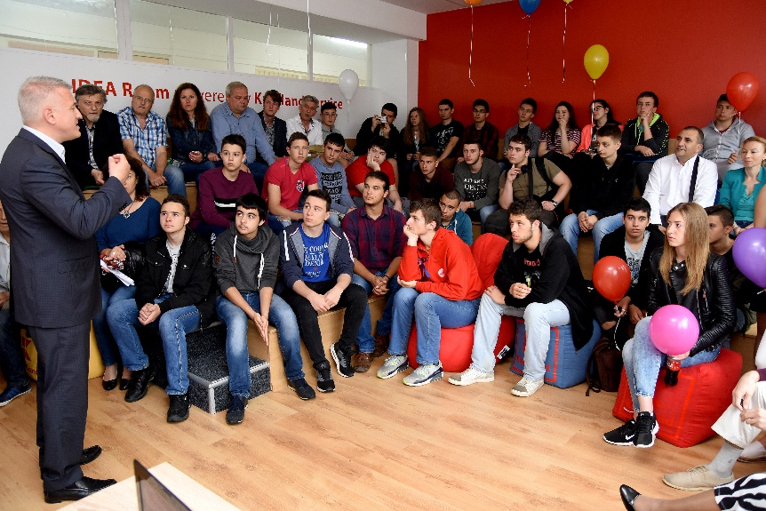
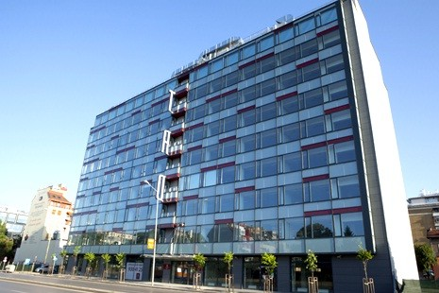
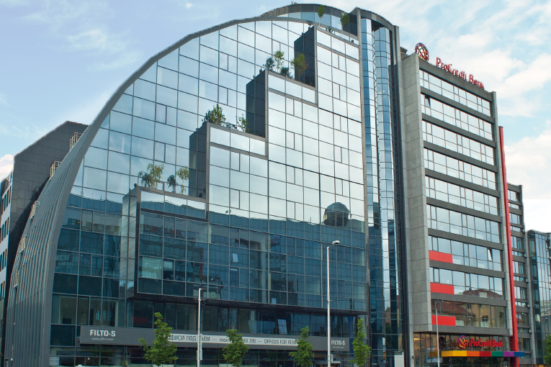







Kaufland – IT HUB
How it All Began …
Our first education
activities start
with an Olympics
We open our
own office
Sofia Center
TAO Building
Our 1st
employee
was hired!
A Strong Hub with
more than 10
development fields,
full pipeline infrastructure
administration and
business support for the
entire group
We are growing
Our 2nd office opens
in Filto Building
We are based in
a small room
at Kaufland HQ BG
School Pravetz and later our own internal ABAP & Java academies
1
35
80
120
240
Sept 2016
June 2017
March 2018
March 2019
Nov/2020

Slide 38
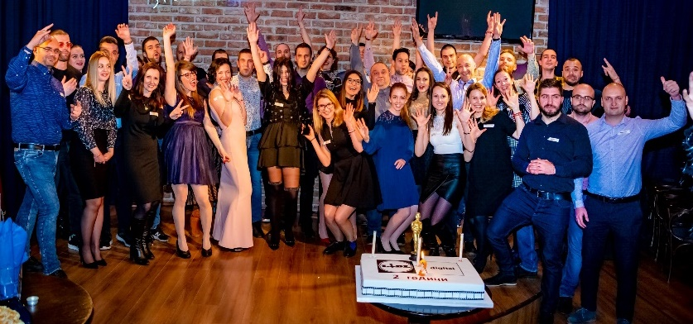
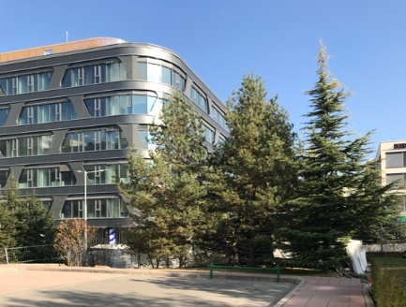

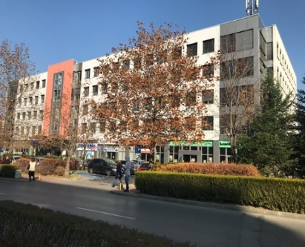


Lidl Digital – COE Sofia
How it all began…
We are growing
Our 2nd office opens in Building 15
Go Live
of our 1st online shop in
Poland
Migration of our
existing
Online Shops
DE, CZ, BE, NL, ES
to the new platform
Our 1st
employee
was hired!
We open our
own office
in Business Park
Sofia Building 3
Go Live of our
2nd online shop
in Slovakia
We are based in
a small room
at Lidl HQ BG
1
15
50
62
65
Late 2017
March 2018
March 2019
2019/2020
Nov/2020

Slide 39

SCHWARZ IT
SIT Bulgaria
01.12.2020

Slide 40
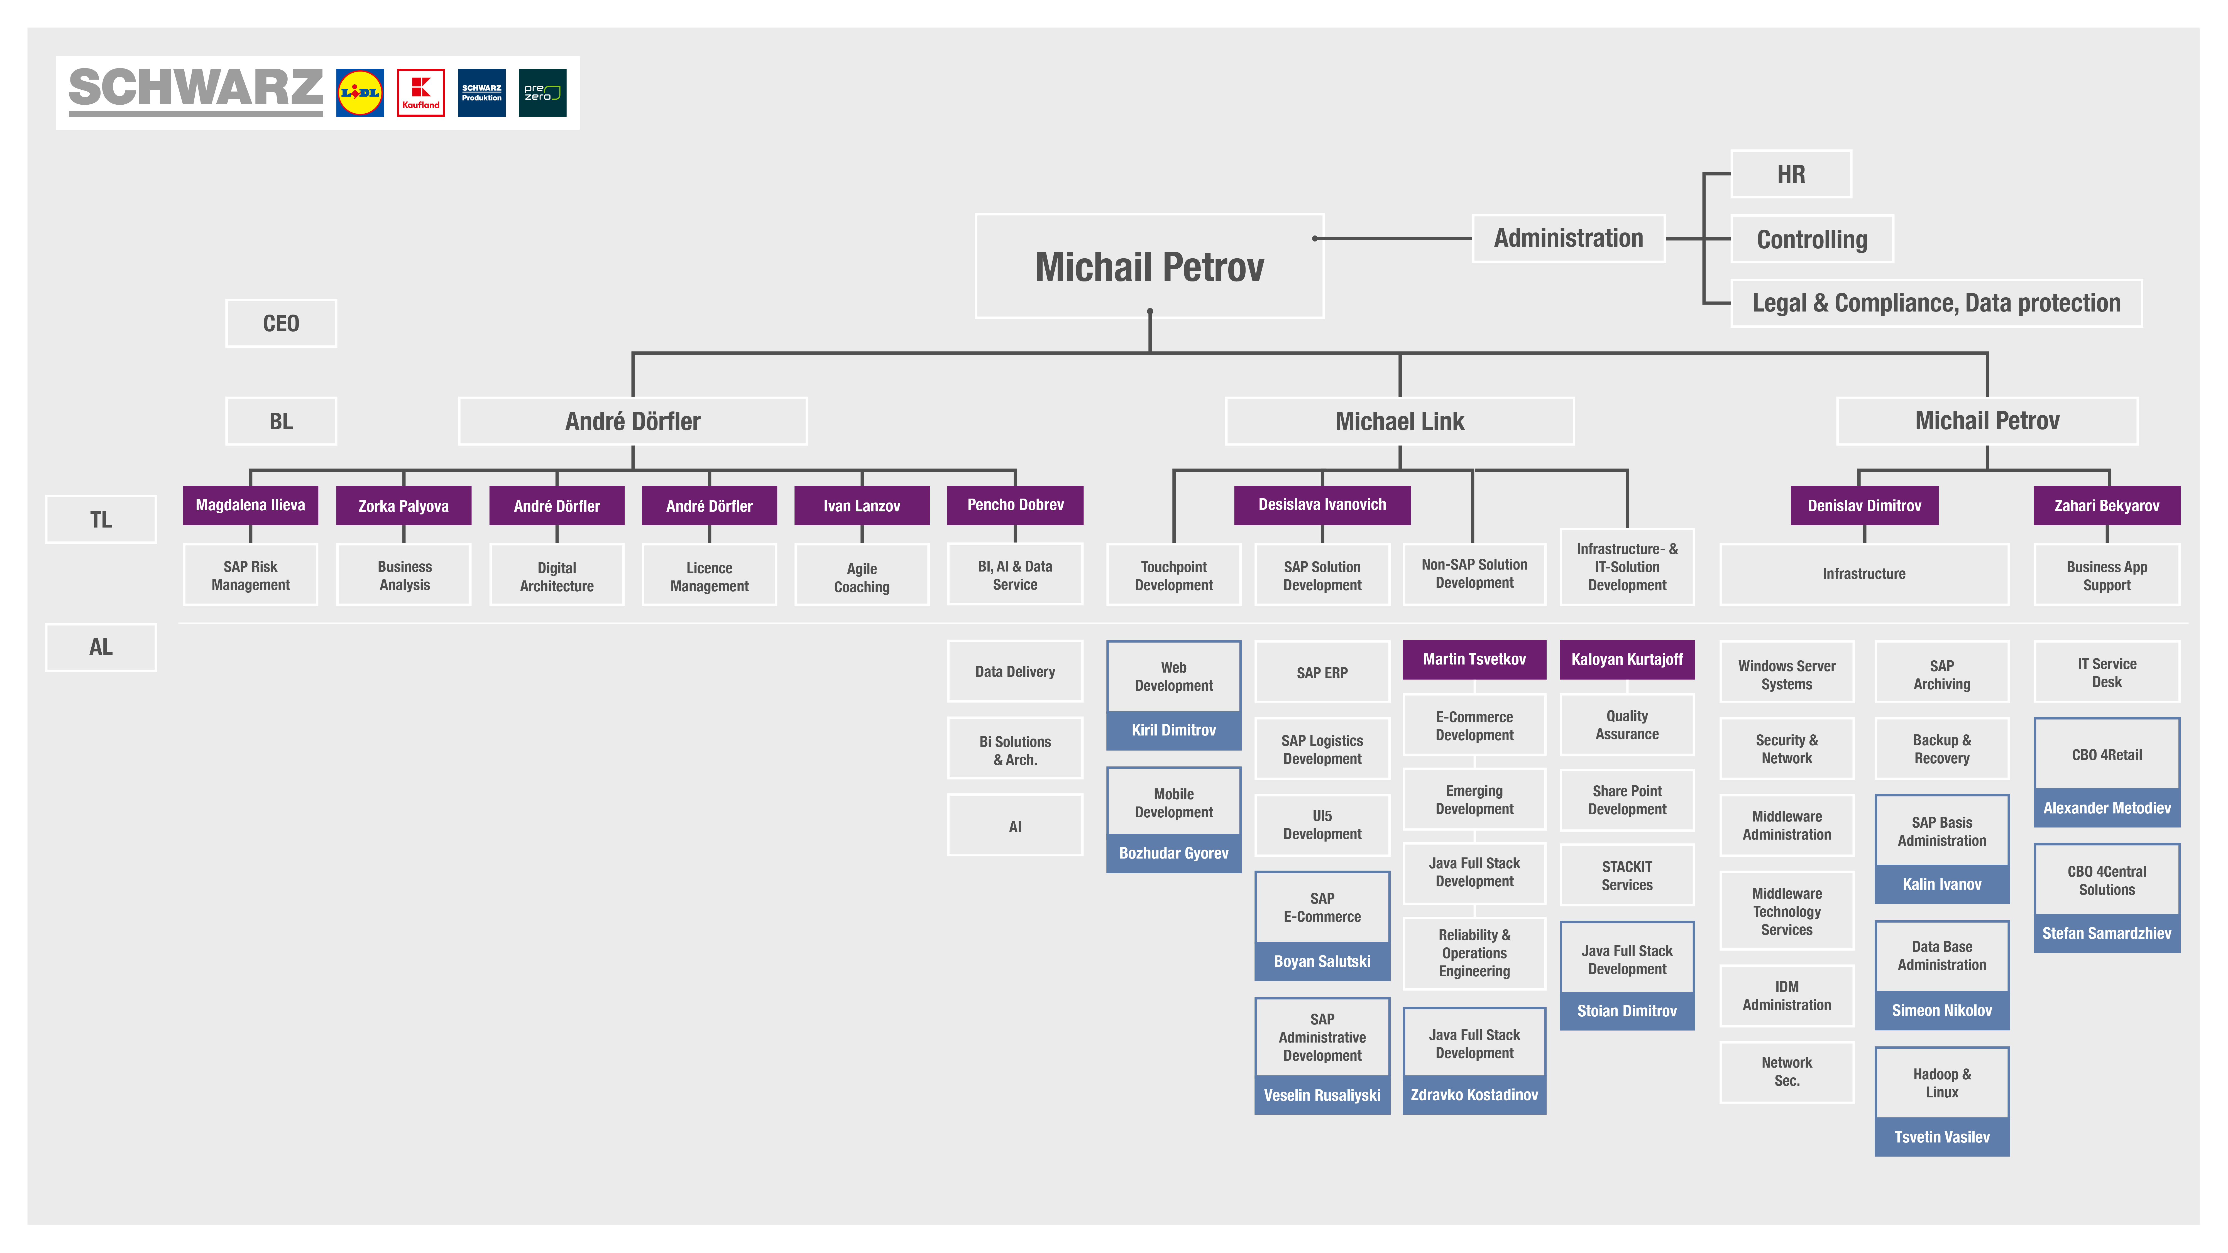

Slide 41
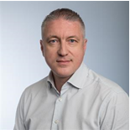
Shcwarz IT Bulgaria
Get to know Michail Petrov – CEO
Previous positions at Schwarz Group: CFO of Kaufland Bulgaria,
CEO of Kaufland Service
Nationality: BG
Work history:
2001 +: Assistant Professor In Marketing, University of National and World Economy, Sofia
03/2000 – 12/2002: Deputy Managing Director, Soravia Group Bulgaria
01/2003 – 11/2004: Regional CFO, Soravia Group Austria
12/2004 – 11/2020: CFO of Kaufland Bulgaria
01/2014 – 12/2019: Member of the Management Board, CFO Club Bulgaria
09/2016 – 11/2020: CEO of IT HUB Kaufland
12/2020 +: CEO of Schwarz IT Bulgaria

Slide 42
We are the
digital heartbeat
of one of the
greatest retailers
in the world.

Slide 43
Our vision
Enthusiasm for innovation,
closeness to people,
understanding the business.
As a strong technology partner
we are the digital heartbeat of the Schwarz Group.
Efficient, fast, and flexible.

Slide 44
Our mission
We secure the Schwarz Group’s diverse and global day-to-day business through stable, secure, and efficient IT solutions.
We make it possible for the departments to implement their business ideas through forward-thinking developments.
We consider ourselves to be a partner on equal footing which is setting new standards with a strong team.
We are independent specialists who are passionate about Schwarz Group’s IT, and we strive to come up with the best and most cost-effective solutions.

Slide 45
We are the digital heartbeat of THE SCHWARZ GROUP
Ownership
The best possible solution is in our hands!
Vision-driven
The best possible solution is one we create!
Values
Partnership
The best possible solution is one we develop together!
Solution-driven
Finding the best possible solution drives us forward!
Enthusiasm
We have fun working out the best possible solution!
Notes:
We enable the business though IT solutions

Slide 46
НАШИТЕ ЦЕННОСТИ
Отговорност
Най-доброто решение е в нашите ръце!
Визионерство
Най-доброто решение е това, което ние сами създаваме!
Решение
Партньорство
Най-доброто решение е това, което разработваме заедно!
Резултатно-ориентирани и целеустремени
Стремежът към най-доброто решение ни движи напред!
Ентусиазъм
Да намерим най-доброто решение е удоволствие за нас!
Notes:
We enable the business though IT solutions

Slide 47





Our company culture

Slide 48
Employer Brand Platform
Schwarz IT
Rational Benefits
Values
Exciting and challenging tasks
Varied tasks from the entire range of IT
Opportunity to quickly take responsibility
Individual freedom and flexibility
Modern equipment and setting
Flexible teamwork
Good conditions and exceptional incentives
Solution Driven, Ownership,
Vision-driven, Enthusiasm,
Partnership
We are the
digital heartbeat
of one of the
biggest retailers
in the world.
We are the
digital heartbeat
of one of the
greatest retailers
in the world.
Emotional Benefits
Tonality
Be part of something bigger
Shared team spirit
Shared passion
International impact of projects
Individual freedom & flexibility
Shared passion for issues
Open & direct communication
90 years of experience
Optimistic and personal
Open and direct
Proactive and on point

Slide 49
Thank you

